Slide 1
Module - 5 (Chapter 5) NAMING
DISTRIBUTED SYSTEMS

Slide 2
Names are used to share resources, to uniquely identify entities, to refer to locations, and more.
Name can be resolved to the entity it refers to. Name resolution thus allows a process to access the named entity.
To resolve names, it is necessary to implement a naming system.
In a distributed system (DS), the implementation of a naming system is itself often distributed across multiple machines.
There are three different important ways that names are used in distributed systems.

Slide 3
Flat-naming
Entities are referred to by an identifier that, in principle, has no meaning at all.
Flat names have no structure, implying that we need special mechanisms to trace the location of such entities.
Human readable names
Often structured, as is well known from the way Web pages are referred to.
Structured names allow for a highly systematic way of finding the server responsible for the named entity, as exemplified by the Domain Name System (DNS).
Characteristics
Describe entities by means of various characteristics.
We need to resolve a description by means of the attributes assigned to an entity.

Slide 4
5.1 NAMES, IDENTIFIERS AND ADDRESSES
A name in a DS is a string of bits or characters that is used to refer to an entity.
An entity in a distributed system can be practically anything. Typical examples include resources such as hosts, printers, disks, and files. Other examples are processes, users, mailboxes, newsgroups, Web pages, graphical windows, messages, network connections, and so on. Entities can be operated on.
1) Printer: Offers an interface containing operations for printing a document, requesting the status of a print job, and the like.
2) Network connection: May provide operations for sending and receiving data, setting quality-of-service parameters, requesting the status, and so forth.

Slide 5
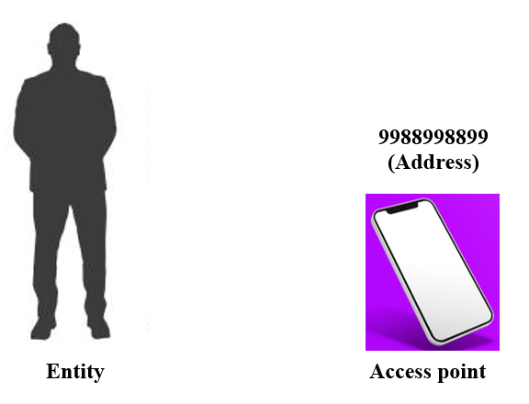
To operate on an entity, it is necessary to access it, for which we need an access point.
An access point is a special kind of entity in a distributed system.
The name of an access point is called an address.
The address of an access point of an entity is also simply called an address of that entity. An entity can offer more than one access point.
Example: A telephone can be viewed as an
access point of a person, whereas the
telephone number corresponds to an address.
People can have several telephone numbers,
each number corresponding to a point
where they can be reached.

Slide 6
Example of an access point in DS is a host running a specific server, with its address formed by the combination of, for example, an IP address and port number.
An entity may change its access points.
Example: When a mobile computer moves to another location, it is often assigned a different IP address than the one it had before. When a person moves to another city or country, it is often necessary to change telephone numbers as well.
An address is thus just a special kind of name: it refers to an access point of an entity.
Because an access point is tightly associated with an entity, it would seem convenient to use the address of an access point as a regular name for the associated entity. This is usually not done as naming is generally very inflexible and often human unfriendly.

Slide 7
Example
A DS is usually reorganized so that a specific server is now running on a different host than previously. The old machine may be reassigned to a different server.
In other words, an entity may easily change an access point, or an access point may be reassigned to a different entity.
If an address is used to refer to an entity, we will have an invalid reference the instant the access point changes or is reassigned to another entity.
Therefore, it is much better to let a service be known by a separate name independent of the address of the associated server.

Slide 8
Likewise, if an entity offers more than one access point, it is not clear which address to use as a reference.
For instance, many organizations distribute their Web service across several servers.
If we would use the addresses of those servers as a reference for the Web service, it is not obvious which address should be chosen as the best one.
Again, a much better solution is to have a single name for the Web service independent from the addresses of the different Web servers.
These examples illustrate that a name for an entity that is independent from its addresses is often much easier and more flexible to use. Such a name is called location independent.

Slide 9
In addition to addresses, there are other types of names to uniquely identify an entity.
A true identifier: A name that has the following properties.
1. An identifier refers to at most one entity.
2. Each entity is referred to by at most one identifier.
3. An identifier always refers to the same entity (i.e., it is never reused).
By using identifiers, it becomes much easier to unambiguously refer to an entity.
Example: Assume two processes each refer to an entity by means of an identifier.
To check if the processes are referring to the same entity, it is sufficient to test if the two identifiers are equal.

Slide 10
Such a test would not be sufficient if the two processes were using regular, nonunique, nonidentifying names.
For example, the name “John Smith” cannot be taken as a unique reference to just a single person.
Likewise, if an address can be reassigned to a different entity, we cannot use an address as an identifier.
Consider the use of telephone numbers, which are reasonably stable in the sense that a telephone number will often for some time refer to the same person or organization.
However, using a telephone number as an identifier will not work, as it can be reassigned in the course of time.
Example: Bakery owner may receive phone calls for old grocery shop.

Slide 11
Addresses and identifiers are two important types of names that are each used for very different purposes.
In many computer systems, addresses and identifiers are represented in machine-readable form only, that is, in the form of bit strings.
For example, an Ethernet address is essentially a random string of 48 bits. Likewise, memory addresses are typically represented as 32-bit or 64-bit strings.

Slide 12
Human-friendly names
An important type of name which is tailored to be used by humans and is generally represented as a character string.
These names appear in many different forms.
Examples
Files in Unix systems have character-string names that can generally be as long as 255 characters, and which are defined entirely by the user.
DNS names are represented as relatively simple case-insensitive character strings.

Slide 13
How do we resolve names and identifiers to addresses?
In principle, a naming system maintains a name-to-address binding which in its simplest form is just a table of (name, address) pairs.
However, in distributed systems that span large networks and for which many resources need to be named, a centralized table is not going to work.
Instead, in DS a name is decomposed into several parts such as ftp.cs.vu.nl. and that name resolution takes place through a recursive lookup of those parts.
For example, a client needing to know the address of the FTP server named by ftp.cs.vu.nl.

Slide 14
Client would first resolve nl to find the server NS(nl) responsible for names that end with nl, after which the rest of the name is passed to server NS(nl).
This server may then resolve the name vu to the server NS(vu.nl) responsible for names that end with vu.nl. who can further handle the remaining name ftp.cs.
Eventually, this leads to routing the name resolution request as:
NS(.) → NS(nl) → NS(vu.nl) → address of ftp.cs.vu.nl.
where NS(.) denotes the server that can return the address of NS(nl), also known as the root server.
NS(vu.nl) will return the actual address of the FTP server.

Slide 15
5.2 FLAT NAMING
Identifiers are convenient to uniquely represent entities.
In many cases, identifiers are simply random bit strings, which we conveniently refer to as unstructured, or flat names.
An important property of such a name is that it does not contain any information whatsoever on how to locate the access point of its associated entity.

Slide 16
Simple solutions
Two simple solutions for locating an entity: broadcasting and forwarding pointers. Both solutions are mainly applicable only to local-area networks.
The use of broadcasting and forwarding pointers imposes scalability problems.
Broadcasting or multicasting is difficult to implement efficiently in large-scale networks.
Long chains of forwarding pointers introduce performance problems and are susceptible to broken links.

Slide 17
Consider a distributed system built on a computer network that offers efficient broadcasting facilities.
Typically, such facilities are offered by local-area networks in which all machines are connected to a single cable. Local-area wireless networks also fall into this category.
Locating an entity in such an environment is simple: a message containing the identifier of the entity is broadcast to each machine and each machine is requested to check whether it has that entity.
Only the machines that can offer an access point for the entity send a reply message containing the address of that access point.

Slide 18
This principle is used in the Internet Address Resolution Protocol (ARP) to find the data-link address of a machine when given only an IP address.
A machine broadcasts a packet on the local network asking who is the owner of a given IP address.
When the message arrives at a machine, the receiver checks whether it should listen to the requested IP address. If so, it sends a reply packet containing, for example, its Ethernet address.

Slide 19
Issues with broadcasting
Broadcasting becomes inefficient when the network grows.
Not only is network bandwidth wasted by request messages, but, more seriously, too many hosts may be interrupted by requests they cannot answer.
Possible solution
Switch to multicasting, by which only a restricted group of hosts receives the request.
Example: Ethernet networks support data-link level multicasting directly in hardware.

Slide 20
Multicasting can also be used to locate entities in point-to-point networks.
For example, the Internet supports network-level multicasting by allowing hosts to join a specific multicast group.
Such groups are identified by a multicast address.
When a host sends a message to a multicast address, the network layer provides a best-effort service to deliver that message to all group members.
A multicast address can be used as a general location service for multiple entities.

Slide 21
Consider an organization where each employee has his or her own mobile computer.
When such a computer connects to the locally available network, it is dynamically assigned an IP address. It joins a specific multicast group.
When a process wants to locate computer A, it sends a “where is A?” request to the multicast group. If A is connected, it responds with its current IP address.
Another way to use a multicast address is to associate it with a replicated entity, and to use multicasting to locate the nearest replica.
When sending a request to the multicast address, each replica responds with its current (normal) IP address.
To select the nearest replica is to choose the one whose reply comes in first.

Slide 22
Forwarding pointers
Popular approach to locate mobile entities.
Principle: When an entity moves from A to B, it leaves behind in A a reference to its new location at B.
Advantage of this approach is its simplicity: as soon as an entity has been located, for example by using a traditional naming service, a client can look up the current address by following the chain of forwarding pointers.

Slide 23
Drawbacks of forwarding pointers
If no special measures are taken, a chain for a highly mobile entity can become so long that locating that entity is prohibitively expensive.
All intermediate locations in a chain will have to maintain their part of the chain of forwarding pointers as long as needed.
Vulnerability to broken links. As soon as any forwarding pointer is lost, the entity can no longer be reached.
An important issue is, therefore, to keep chains relatively short, and to ensure
that forwarding pointers are robust.

Slide 24
Home-based approaches
A popular approach to supporting mobile entities in large-scale networks is to introduce a home location, which keeps track of the current location of an entity.
In practice, the home location is often chosen to be the place where an entity was created.
The home-based approach is used as a fall-back mechanism for location services based on forwarding pointers.

Slide 25
Mobile IP
Home based approach is followed in Mobile IP.
Each mobile host uses a fixed IP address. All communication to that IP address is initially directed to the mobile host’s home agent.
This home agent is located on the local-area network corresponding to the network address contained in the mobile host’s IP address. In the case of IPv6, it is realized as a network-layer component.
Whenever the mobile host moves to another network, it requests a temporary address that it can use for communication. This care-of address is registered at the home agent.

Slide 26
When the home agent receives a packet for the mobile host, it looks up the host’s current location.
If the host is on the current local network, the packet is simply forwarded. Otherwise, it is tunneled to the host’s current location, that is, wrapped as data in an IP packet and sent to the care-of address.
At the same time, the sender of the packet is informed of the host’s current location.
This principle is shown in Figure 5.3.

Slide 27
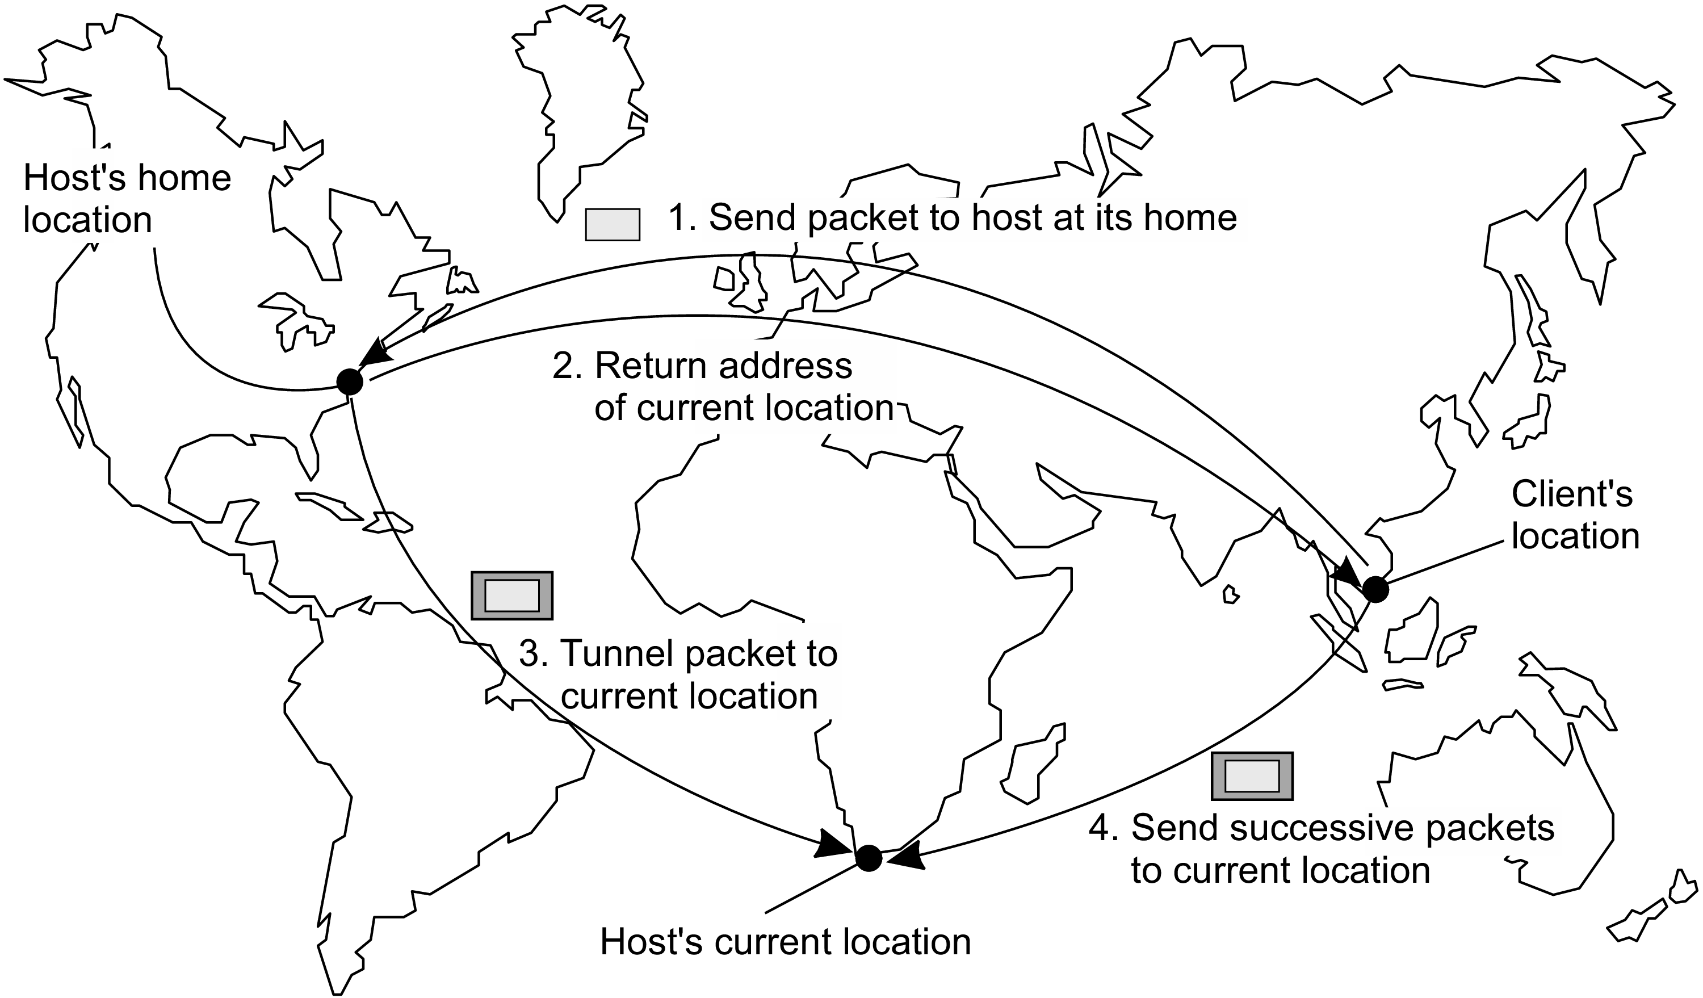
Figure 5.3: The principle of Mobile IP.

Slide 28
An important aspect is that this whole mechanism is largely hidden for applications.
In other words, the original IP address associated with the mobile host can be used by an application without further difficulty.
Client-side software that is part of the application-independent communication layer will handle the redirection to the target’s current location.
Likewise, at the target’s location, a message that has been tunneled will be unpacked and handed to the application on the mobile host as if it were using its original address. Mobile IP establishes a high degree of location transparency.

Slide 29
Drawbacks of home-based approaches
Figure 5.3 also illustrates a drawback of home-based approaches in largescale networks.
To communicate with a mobile entity, a client first has to contact the home, which may be at a completely different location than the entity itself. The result is an increase in communication latency.
Another drawback of the home-based approach is the use of a fixed home location. For one thing, it must be ensured that the home location always exists. Otherwise, contacting the entity will become impossible.

Slide 30
Problems are aggravated (worse) when a long-lived entity decides to move permanently to a completely different part of the network than where its home is located. Better is to move the home along with the host.
A solution to this problem is to register the home at a traditional naming service and to let a client first look up the location of the home.
Because the home location can be assumed to be relatively stable, that location can be effectively cached after it has been looked up.

Slide 31
Distributed Hash Tables (DHT)
How to resolve an identifier to the address of the associated entity ?
We use Distributed Hash Tables (DHT) and we consider Chord system as an easy-to-explain DHT-based system.
General mechanism
Chord uses an m-bit identifier space to assign randomly chosen identifiers to nodes as well as keys to specific entities.
The entities can be virtually anything: files, processes, etc.

Slide 32
The number m of bits is usually 128 or 160, depending on which hash function is used.
An entity with key k falls under the jurisdiction of the node with the smallest identifier This node is referred to as the successor of k and denoted as succ(k).
To keep our notation simple and consistent, in the following we refer to a node with identifier p as node p.
The main issue in DHT-based systems is to efficiently resolve a key k to the address of succ(k).

Slide 33
An obvious nonscalable approach is to let each node p keep track of the successor succ(p + 1) as well as its predecessor pred(p).
In that case, whenever a node p receives a request to resolve key k, it will simply forward the request to one of its two neighbors – whichever one is appropriate -
unless pred(p) < k <= p in which case node p should return its own address to
the process that initiated the resolution of key k.
(Note: This is used as a terminating condition)

Slide 34
Instead of this linear approach toward key lookup, each Chord node maintains a finger table containing s <= m entries. If FTp denotes the finger table of node p, then,
FTp[i] = succ(p + 2^{i-1})
i.e., the i-th entry points to the first node succeeding p by at least 2^{i-1}
These references are actually shortcuts to existing nodes in the identifier space, where the short-cutted distance from node p increases exponentially as the index in the finger table increases.

Slide 35
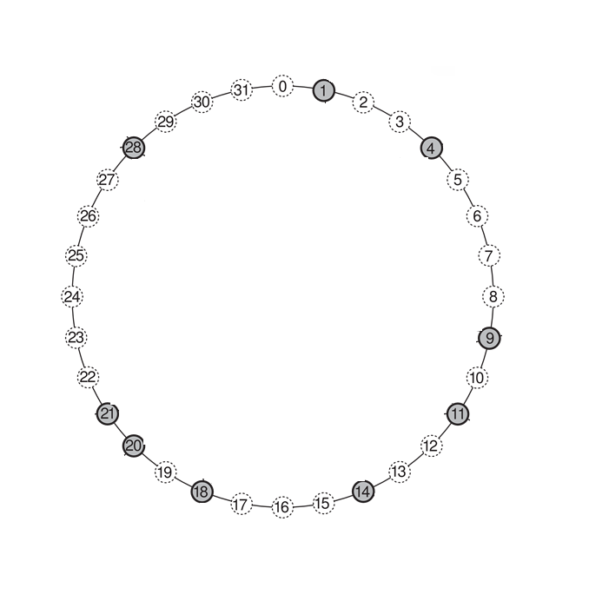
Example scenario of
Finger Table generation. In this, there are 32 nodes in the chord and 5 bits are used for representation. m=5.
And hence each node which is responsible for storing finger table has 5 entries.
The nodes which are string the finger table are highlighted/shaded.

Slide 36
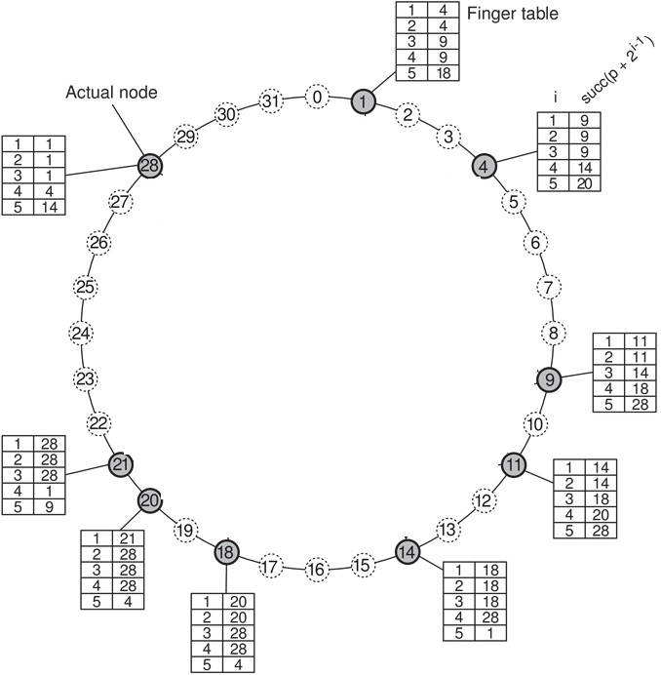
Finger tables at each highlighted node is generated by using this rule.
FTp[i] = succ(p + 2^{i-1})
i.e., the i-th entry points
to the first node
succeeding p
by at least 2^{i-1}

Slide 37
To look up a key k, node p will then immediately forward the request to node q with index j in p’s finger table where:
q = FTp[j] <= k < FTp[j + 1]
OR
q = FTp[1] when p < k < FTp[1].

Slide 38
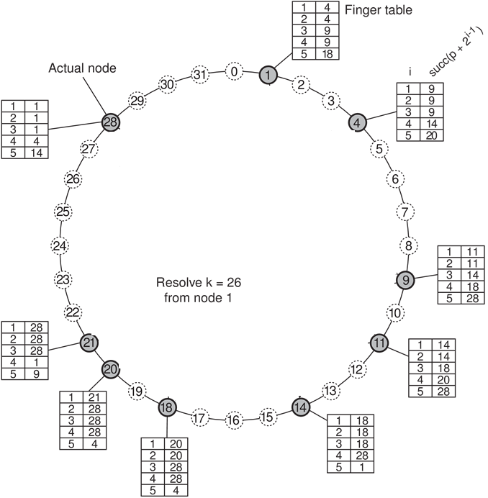
To illustrate the lookup,
consider resolving k = 26 from node 1 as shown in Figure 5.4.

Slide 39
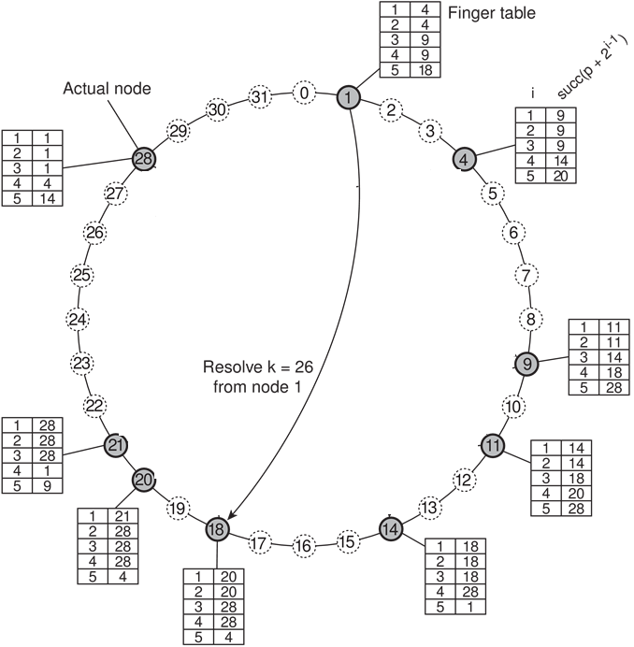
First, node 1 will look up
k = 26 in its finger table to
discover that this value is
larger than FT₁[5],
meaning that the request
will be forwarded to node 18 = FT₁[5].

Slide 40
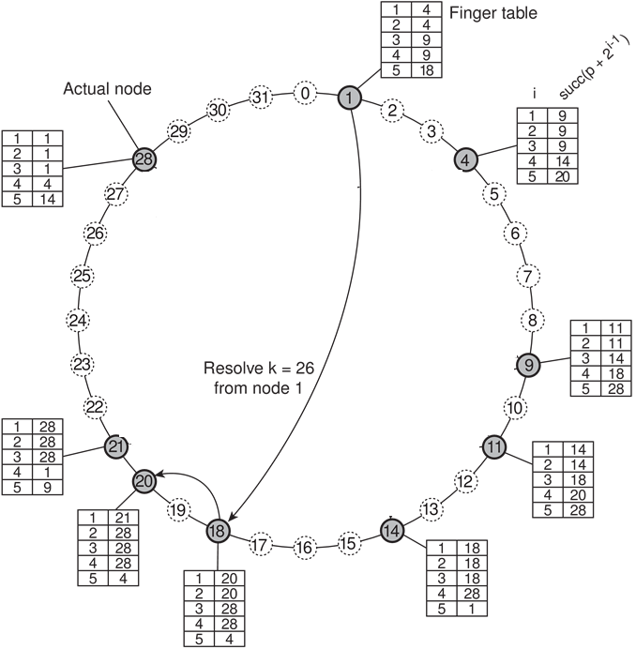
Node 18, will select node 20, as per condition
q = FTp[j] <= k < FTp[j + 1]
FT₁₈[2] <= k < FT₁₈[3].
i.e., 20 <= 26 < 28

Slide 41

Then the request is forwarded
from node 20 to node 21 as per the condition
q = FTp[j]<= k < FTp[j + 1]
FT₂₀[1] <= k < FT₂₀[2].
i.e., 21 <= 26 < 28

Slide 42
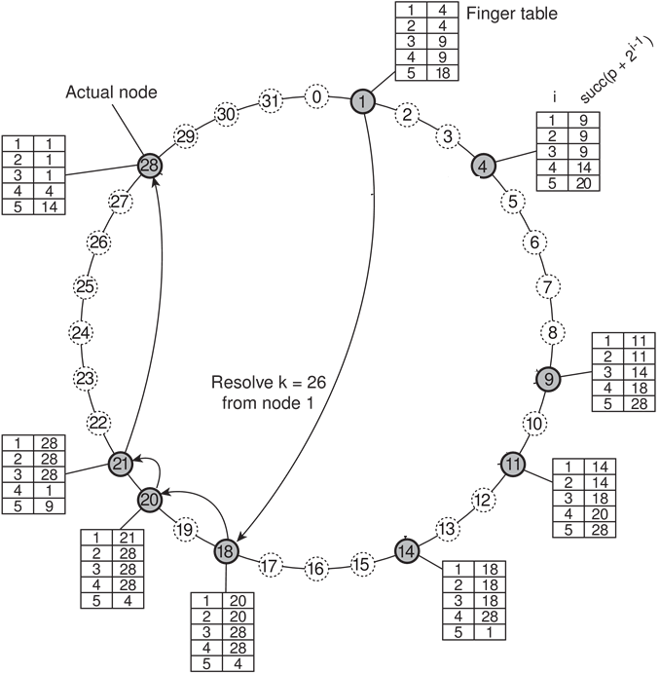
Finally from node 21 to node 28,
as we know that,
q = FTp[1] when p < k < FTp[1].
21 < 26 < FT₂₁[1]
i.e., 21 < 26 < 28

Slide 43
At node 28
When applying the property pred(p) < k <= p in which case node p should return its own address to the process that initiated the resolution of key k..
As per the above property : pred(p) < k <= p ➔ 21 < 26 <= 28 ➔ True
Hence node 28 is responsible for k = 26. Hence address of node 28 is returned to node 1 and the key has been resolved.

Slide 44
SUMMARY
Node 18, will select node 20, as per condition
q = FTp[j] <= k < FTp[j + 1]
FT₁₈[2] <= k < FT₁₈[3]. ➔ i.e., 20 <= 26 < 28
Then the request is forwarded from node 20 to node 21 as per the condition
q = FTp[j]<= k < FTp[j + 1]
FT₂₀[1] <= k < FT₂₀[2]. ➔ i.e., 21 <= 26 < 28
Finally from node 21 to node 28, as we know that,
q = FTp[1] when p < k < FTp[1].
21 < 26 < FT₂₁[1] ➔ i.e., 21 < 26 < 28

Slide 45
At node 28
When applying the property pred(p) < k <= p in which case node p should return its own address to the process that initiated the resolution of key k..
As per the above property : pred(p) < k <= p ➔ 21 < 26 <= 28 ➔ True
Hence node 28 is responsible for k = 26. Hence address of node 28 is returned to node 1 and the key has been resolved.
For similar reasons, when node 28 is requested to resolve the key k = 12, a request will be routed as shown by the dashed line in Figure 5.4. A lookup will generally require O(log(N)) steps, with N being the number of nodes in the system.

Slide 46
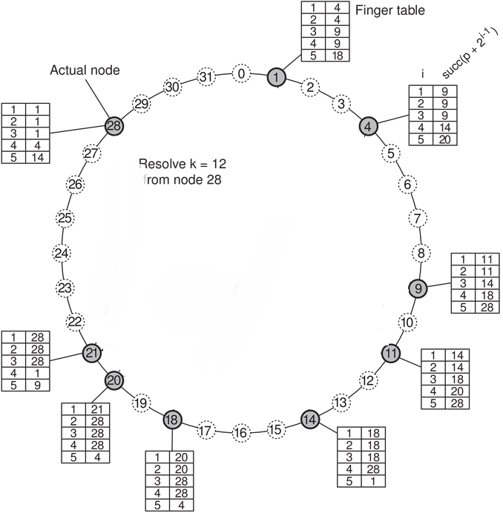
ANOTHER EXAMPLE
When node 28 is requested
to resolve the key k = 12.

Slide 47

Node 28, will select node 4
as per the condition
q = FTp[j] <= k < FTp[j + 1]
FT28[4] <= k < FT18[5]
i.e., 4 <= 12 < 14

Slide 48

Node 4, will select node 9
as per condition
q = FTp[j] <= k < FTp[j + 1]
FT4[3] <= k < FT4[4]
i.e., 9 <= 12 < 14

Slide 49
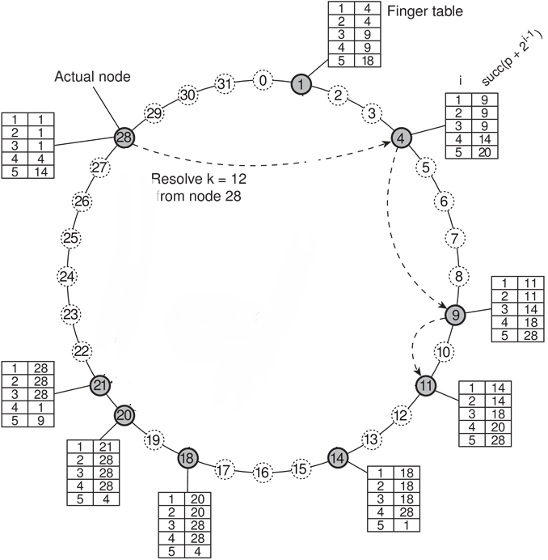
Node 9, will select node 11
as per condition
q = FTp[j] <= k < FTp[j + 1]
FT9[2] <= k < FT9[3]
i.e., 11 <= 12 < 14

Slide 50

At node 11 the condition,
q = FTp[j] <= k < FTp[j + 1]
is not satisfied,
Hence WKT, q = FTp[1]
when p < k < FTp[1].
At node 11,
q = p < k < FTp[1]
11<12<14
Hence 11 will select 14.

Slide 51
At node 14
When applying the property pred(p) < k <= p in which case node p should
return its own address to the process that initiated the resolution of key k.
As per the above property : pred(p) < k <= p ➔ 11 < 12 <= 14 ➔ True
Hence node 14 is responsible for k = 12. Hence address of node 14 is returned
to node 28 and the key has been resolved.

Slide 52
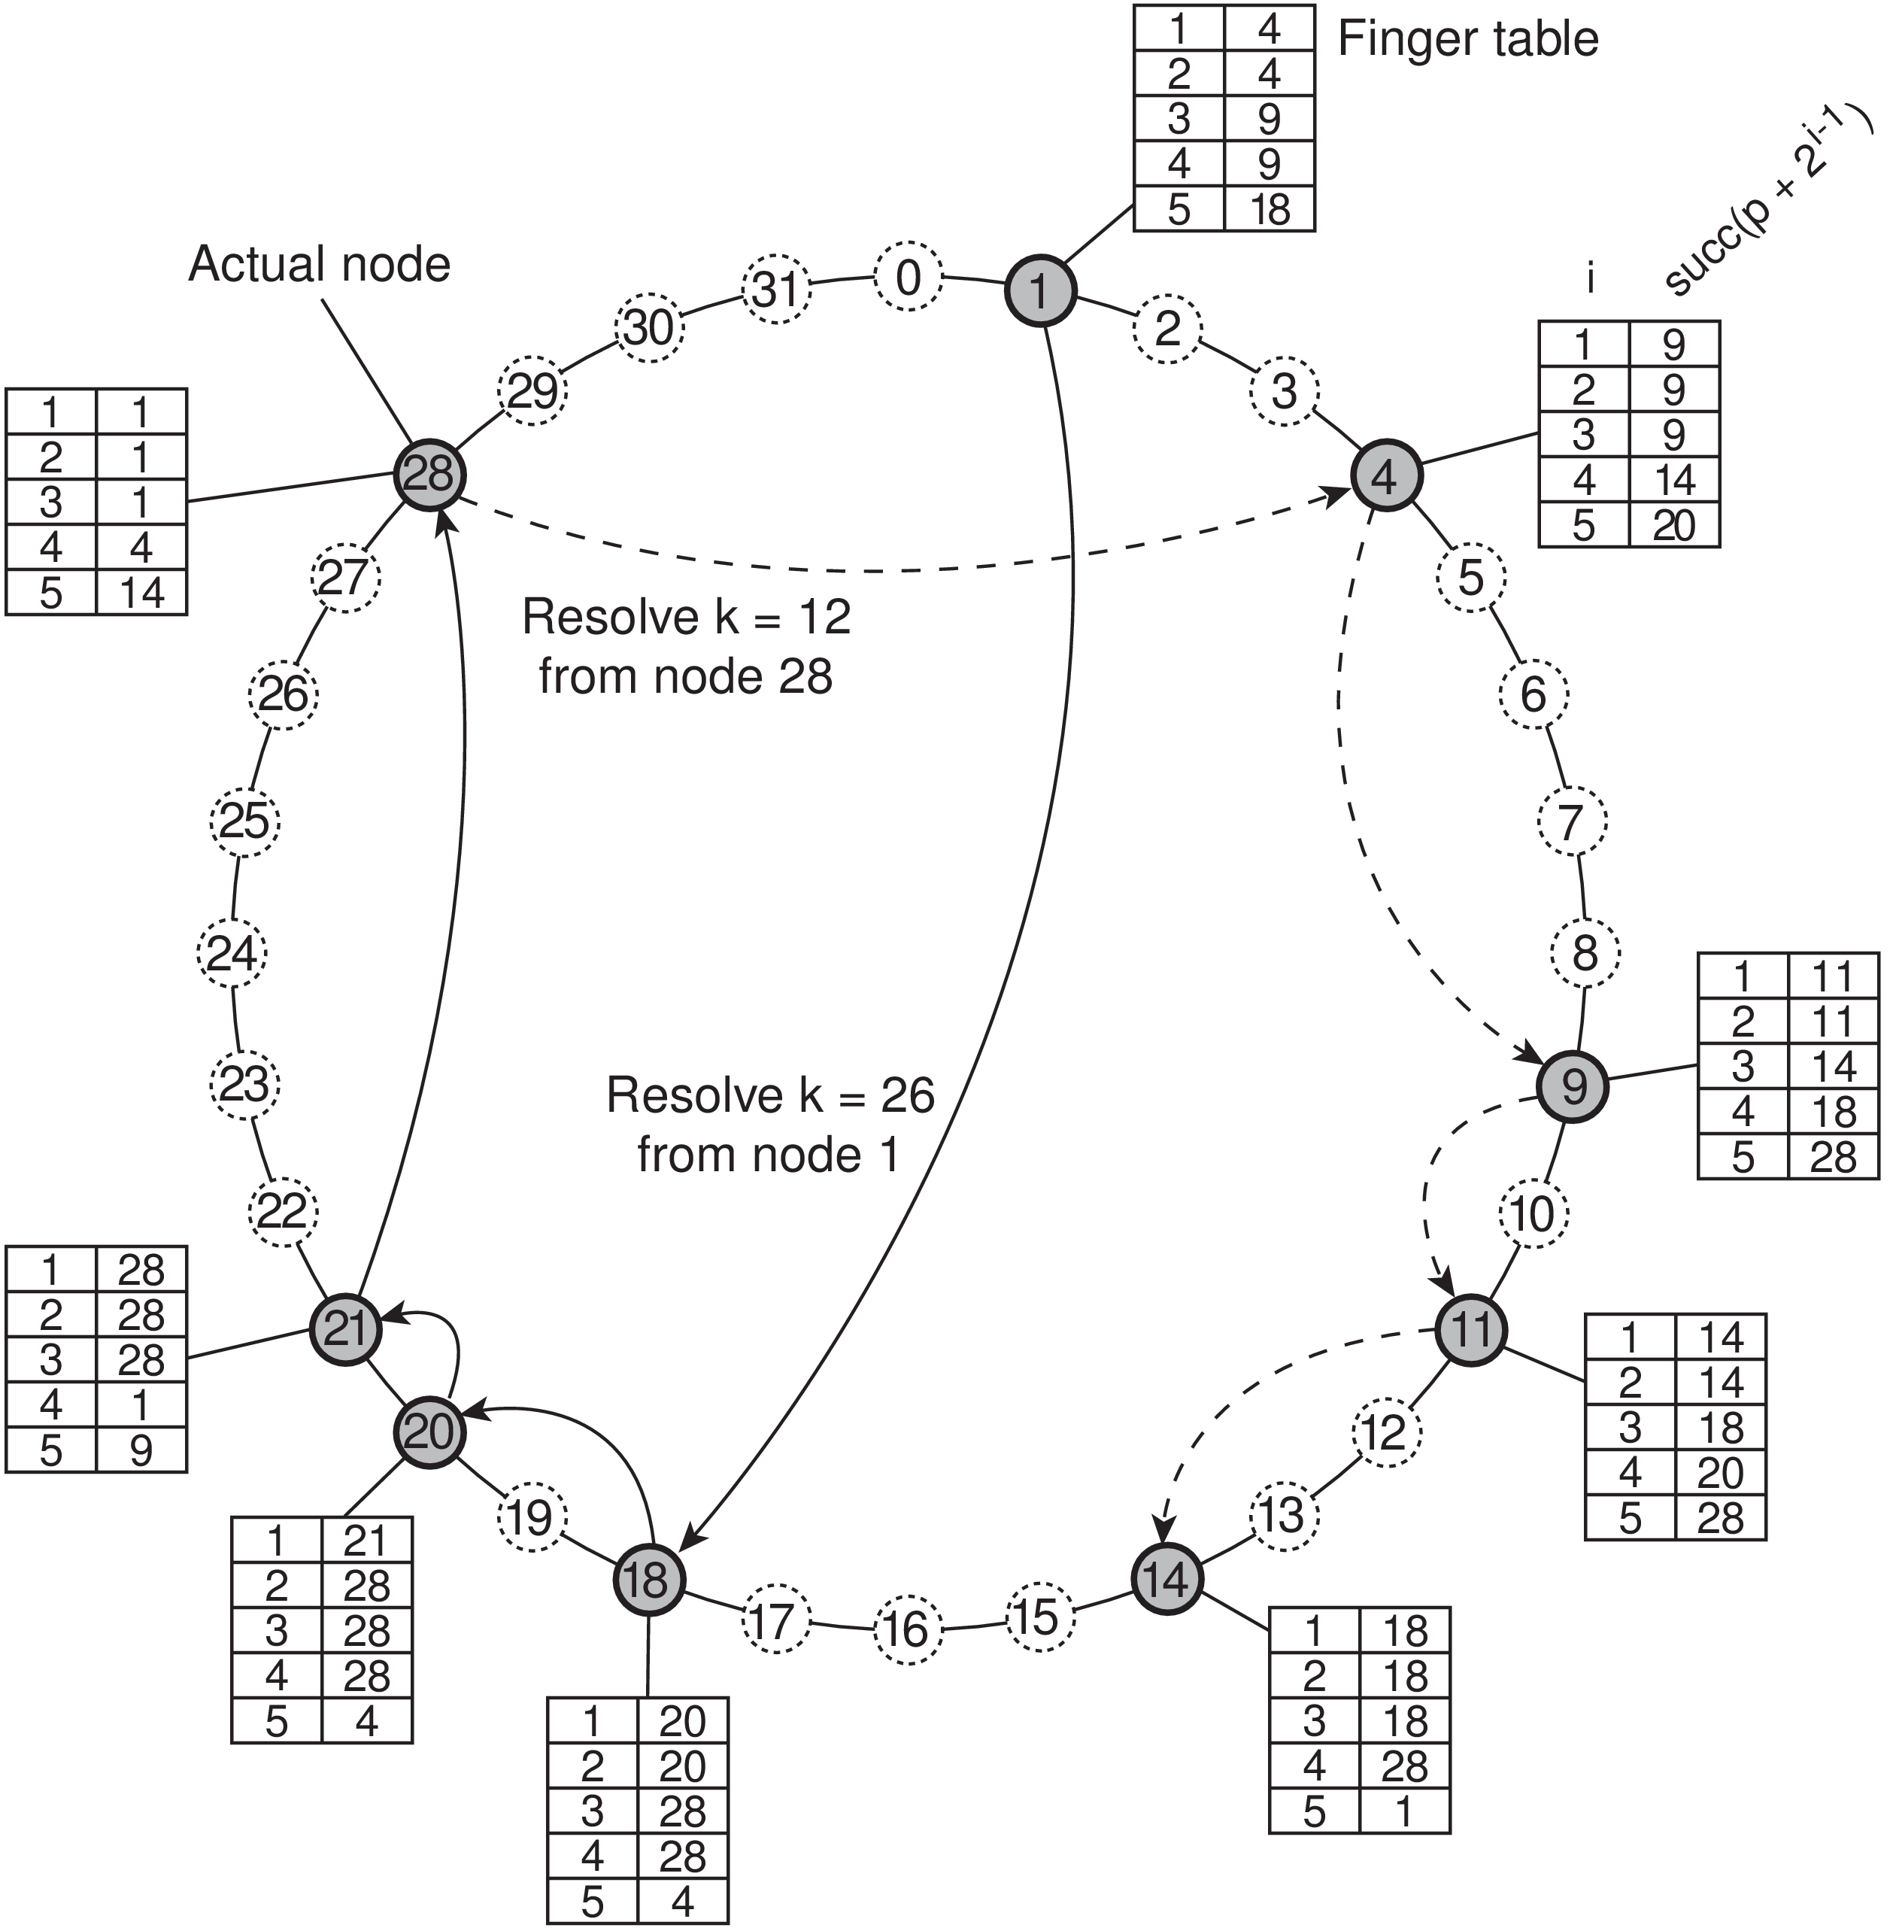
Figure 5.4: Resolving key 26 from node 1 and key 12 from node 28 in a Chord system.

Slide 53
In large distributed systems the collection of participating nodes can be expected to change all the time.
Not only will nodes join and leave voluntarily, we also need to consider the case of nodes failing (and thus effectively leaving the system), to later recover again (at which point they rejoin).
Joining a DHT-based system such as Chord is relatively simple.
Suppose node p wants to join. It simply contacts an arbitrary node in the existing system and requests a lookup for succ(p + 1). Once this node has been identified, p can insert itself into the ring. Likewise, leaving can be simple. Note that nodes also keep track of their predecessor.

Slide 54
The complexity comes from keeping the finger tables up-to-date.
Most important is that for every node q, FTq[1] is correct as this entry refers to the next node in the ring, that is, the successor of q + 1.
In order to achieve this goal, each node q regularly runs a simple procedure that contacts succ(q + 1) and requests to return pred(succ(q + 1)).
If q = pred(succ(q + 1)) then q knows its information is consistent with that of its successor.

Slide 55
Otherwise, if q’s successor has updated its predecessor, then apparently a new node p had entered the system, with q < p <= succ(q + 1), so that q will adjust FTq[1] to p.
At that point, it will also check whether p has recorded q as its predecessor. If not, another adjustment of FTq[1] is needed.
In a similar way, to update a finger table, node q simply needs to find the successor for k = q + 2^{i-1} for each entry i. Again, this can be done by issuing a request to resolve succ(k).
In Chord, such requests are issued regularly by means of a background process.

Slide 56
Likewise, each node q will regularly check whether its predecessor is alive.
If the predecessor has failed, the only thing that q can do is record the fact by setting pred(q) to “unknown”.
On the other hand, when node q is updating its link to the next known node in the ring, and finds that the predecessor of succ(q+1) has been set to “unknown,” it will simply notify succ(q+1) that it suspects it to be the predecessor.
By and large, these simple procedures ensure that a Chord system is generally consistent, only perhaps with exception of a few nodes.

Slide 57
Hierarchical approaches
In a hierarchical scheme, a network is divided into a collection of domains. There is a single top-level domain that spans the entire network.
Each domain can be subdivided into multiple, smaller subdomains. A lowest-level domain, called a leaf domain, typically corresponds to a local-area network in a computer network or a cell in a mobile telephone network.
The general assumption is that within a smaller domain the average time it takes to transfer a message from one node to another is less than in a large domain.

Slide 58
Each domain D has an associated directory node dir(D) that keeps track of the entities in that domain. This leads to a tree of directory nodes.
The directory node of the top-level domain, called the root (directory) node, knows about all entities. This general organization of a network into domains and directory nodes is illustrated in Figure 5.6.
To keep track of the whereabouts of an entity, each entity currently located in a domain D is represented by a location record in the directory node dir(D).

Slide 59
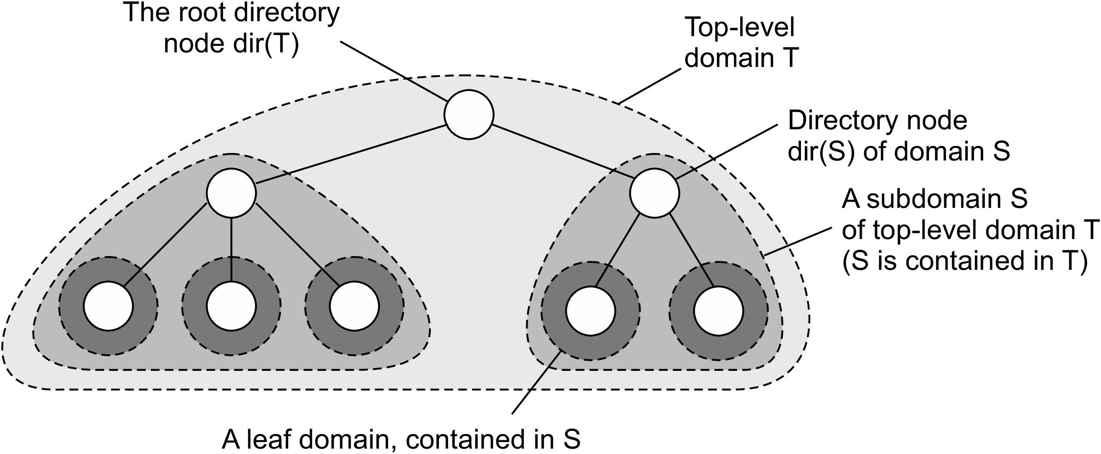
Figure 5.6: Hierarchical organization of a location service into domains,
each having an associated directory node.

Slide 60
A location record for entity E in the directory node N for a leaf domain D contains the entity’s current address in that domain.
In contrast, the directory node N¹ for the next higher-level domain D¹ that contains D, will have a location record for E containing only a pointer to N.
Likewise, the parent node of N¹ will store a location record for E containing only a pointer to N¹.
Consequently, the root node will have a location record for each entity, where each location record stores a pointer to the directory node of the next lower-level subdomain where that record’s associated entity is currently located.

Slide 61
ROOT NODE
Location record for each entity - E
Pointer to the directory node of next lower level subdomain
Parent Node of N¹
Location record for entity - E
Only a pointer to N¹
Domain – D¹
Directory Node - N¹
Location record for entity - E
Only a pointer to N
Leaf Domain - D
Directory Node - N
Location record for entity - E
Entity’s Current Address

Slide 62
An entity may have multiple addresses, for example if it is replicated.
If an entity has an address in leaf domain D1 and D2 respectively, then the directory node of the smallest domain containing both D1 and D2, will have two pointers, one for each subdomain containing an address.
This leads to the general organization of the tree as shown in Figure 5.7.

Slide 63
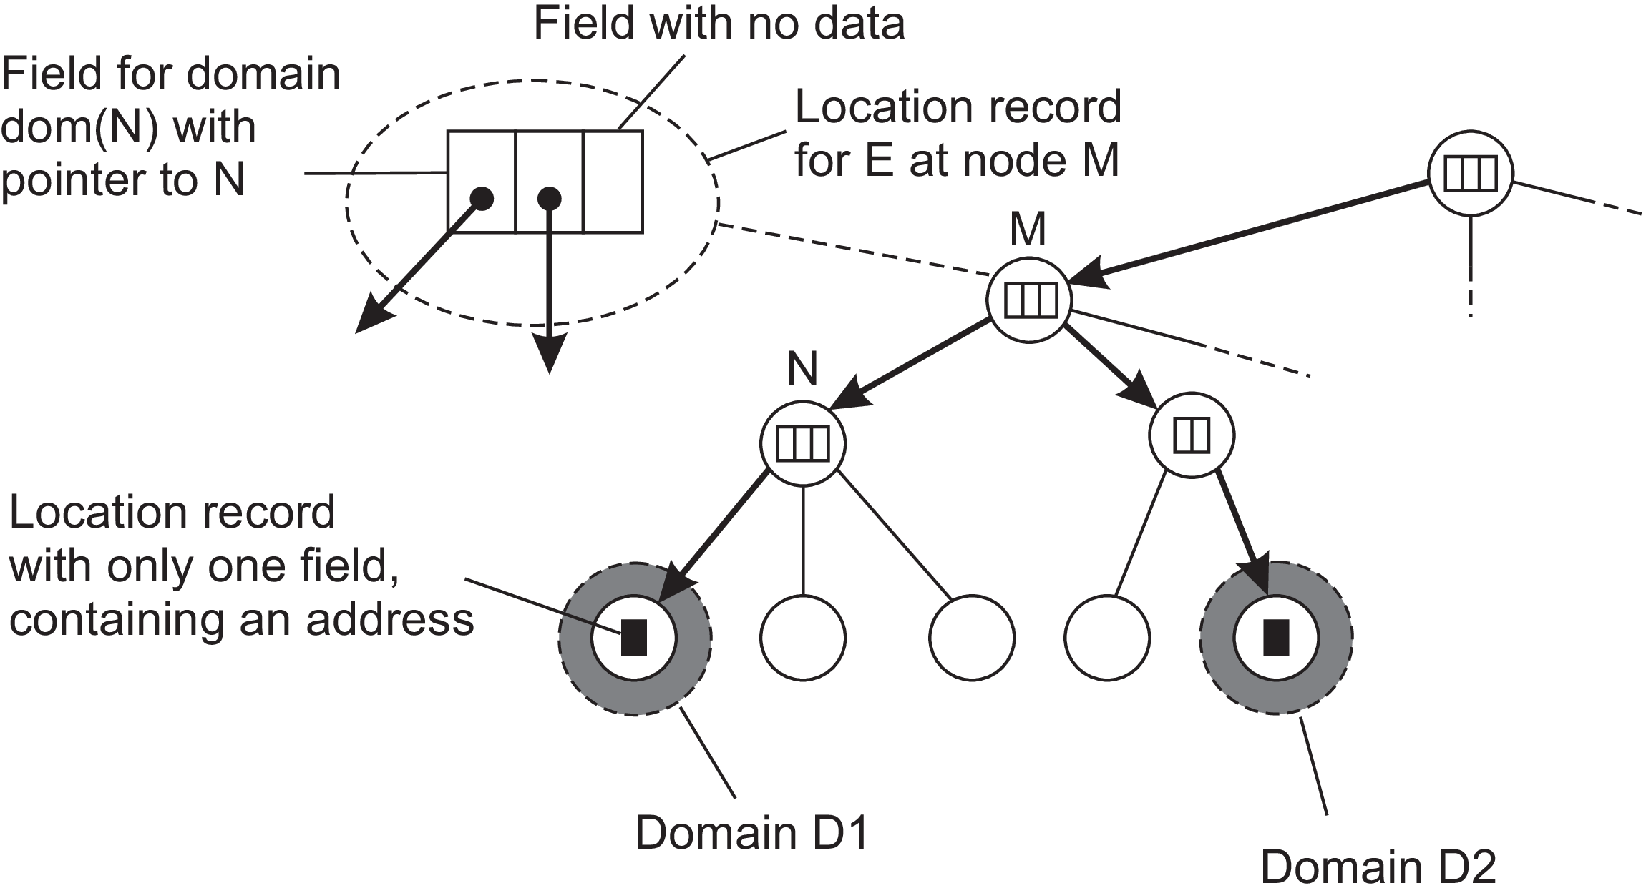
Figure 5.7: An example of storing information of an entity having two addresses in different leaf domains.

Slide 64
Lookup operation in hierarchical location service
As is shown in Figure 5.8, a client wishing to locate an entity E, issues a lookup request to the directory node of the leaf domain D in which the client resides.
If the directory node does not store a location record for the entity, then the entity is currently not located in D. Consequently, the node forwards the request to its parent.
The parent node represents a larger domain than its child. If the parent also has no location record for E, the lookup request is forwarded to a next level higher, and so on.

Slide 65
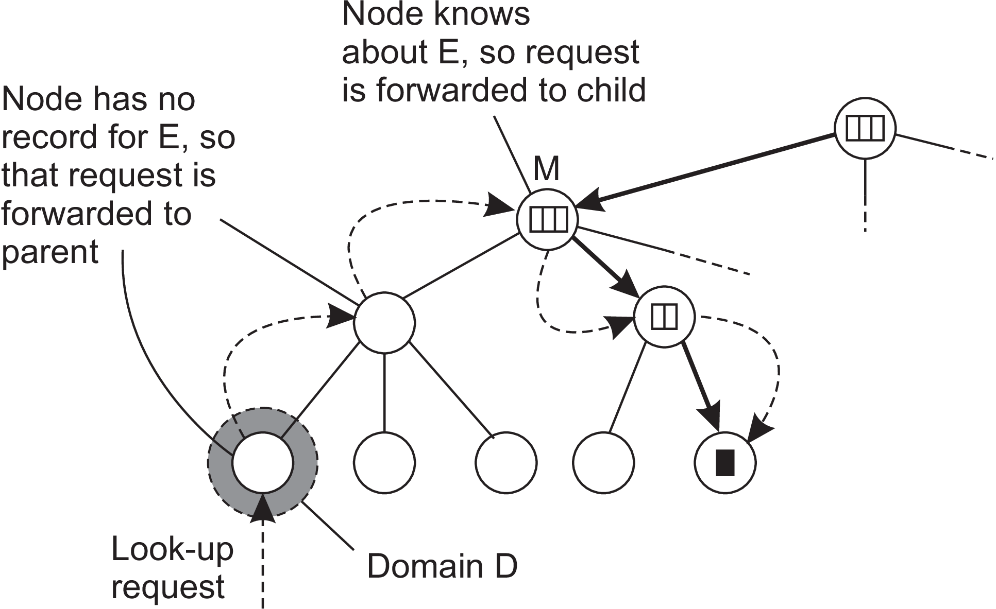
Figure 5.8: Looking up a location in a hierarchically organized location service.

Slide 66
As soon as the request reaches a directory node M that stores a location record for entity E, we know that E is somewhere in the domain dom(M) represented by node M.
In Figure 5.8, M is shown to store a location record containing a pointer to one of its subdomains. The lookup request is then forwarded to the directory node of that subdomain, which in turn forwards it further down the tree, until the request finally reaches a leaf node.
The location record stored in the leaf node will contain the address of E in that leaf domain. This address can then be returned to the client that initially requested the lookup to take place.

Slide 67
In hierarchical location services the lookup operation exploits (Make best use of) locality.
In principle, the entity is searched in a gradually increasing ring centered around the requesting client. The search area is expanded each time the lookup request is forwarded to a next higher-level directory node.
In the worst case, the search continues until the request reaches the root node. Because the root node has a location record for each entity, the request can then simply be forwarded along a downward path of pointers to one of the leaf nodes.
Update operations exploit locality in a similar fashion, as shown in Figure 5.9.

Slide 68
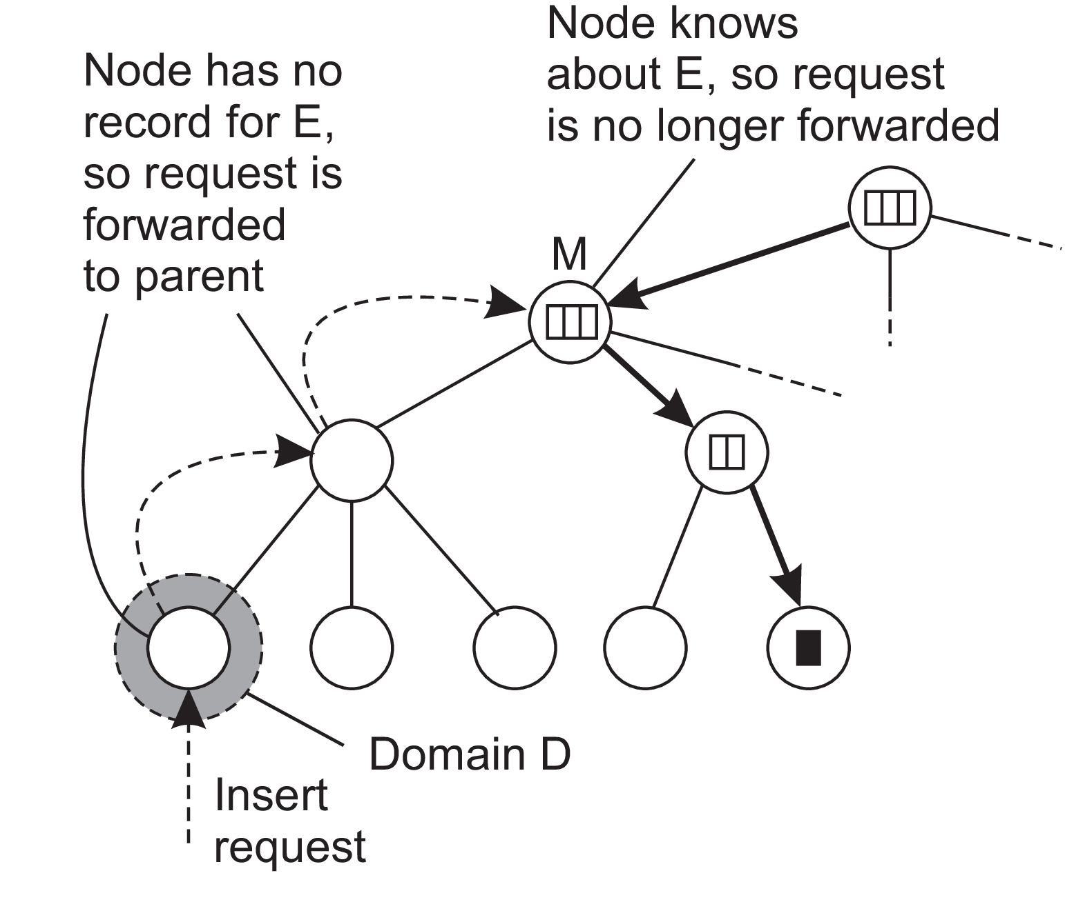
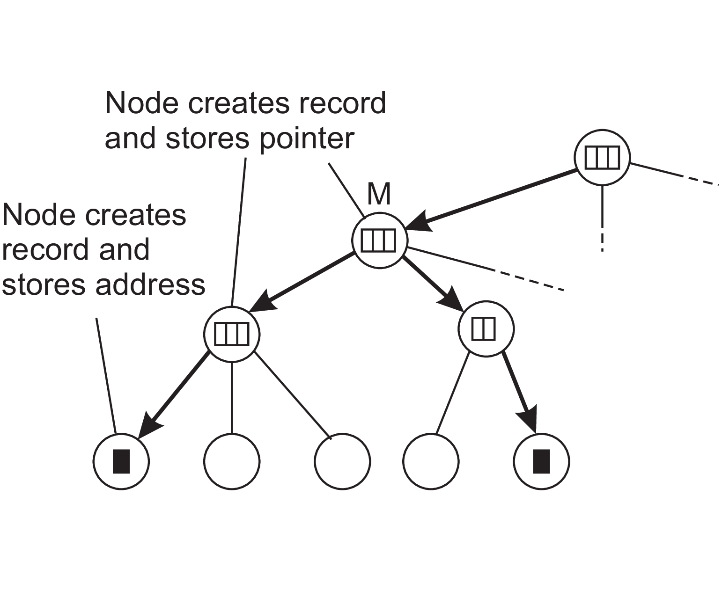
(a) (b)
Figure 5.9: (a) An insert request is forwarded to the first node that knows
about entity E. (b) A chain of forwarding pointers to the leaf node is created.

Slide 69
Consider an entity E that has created a replica in leaf domain D for which it needs to insert its address. The insertion is initiated at the leaf node dir(D) of D which immediately forwards the insert request to its parent.
The parent will forward the insert request as well, until it reaches a directory node M that already stores a location record for E.
Node M will then store a pointer in the location record for E, referring to the child node from where the insert request was forwarded.
At that point, the child node creates a location record for E, containing a pointer to the next lower-level node from where the request came.

Slide 70
This process continues until we reach the leaf node from which the insert was initiated.
The leaf node, finally, creates a record with the entity’s address in the associated leaf domain.
Inserting an address as just described leads to installing the chain of pointers in a top-down fashion starting at the lowest-level directory node that has a location record for entity E.
An alternative is to create a location record before passing the insert request to the parent node. i.e., the chain of pointers is constructed from the bottom up.

Slide 71
The advantage of bottom up is that an address becomes available for lookups as soon as possible.
Consequently, if a parent node is temporarily unreachable, the address can still be looked up within the domain represented by the current node.
Delete operation: Analogous to an insert operation.
When an address for entity E in leaf domain D needs to be removed, directory node dir(D) is requested to remove that address from its location record for E.
If that location record becomes empty, that is, it contains no other addresses for E in D, the record can be removed. In that case, the parent node of dir(D) wants to remove its pointer to dir(D).

Slide 72
If the location record for E at the parent now also becomes empty, that record should be removed as well and the next higher-level directory node should be informed.
Again, this process continues until a pointer is removed from a location record that remains nonempty afterward or until the root is reached.

Slide 73
5.3 STRUCTURED NAMING
Flat names are good for machines and they are not human readable.
Structured naming system is composed of simple, human-readable names.
File naming and host naming on the Internet follow this approach.
Discussion involves structured names and the way that these names are resolved to addresses.

Slide 74
Name spaces
Names are commonly organized into a name space.
Name spaces for structured names can be represented as a labeled, directed graph with two types of nodes.
Leaf node
It represents a named entity and has the property that it has no outgoing edges.
It generally stores information on the entity it is representing–for example, its address–so that a client can access it.

Slide 75
Alternatively, it can store the state of that entity, such as in the case of file systems in which a leaf node actually contains the complete file it is representing.
Directory node
It has a number of outgoing edges, each labeled with a name, as shown in Figure 5.11.
Each node in a naming graph is considered as yet another entity in a distributed system, and, in particular, has an associated identifier.
A directory node stores a table in which an outgoing edge is represented as a pair (node identifier, edge label). Such a table is called a directory table.

Slide 76
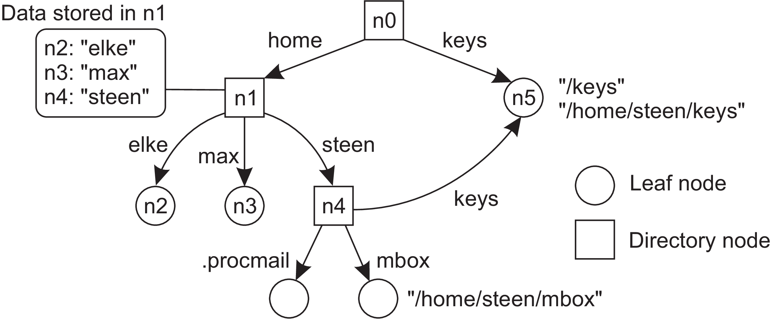
Figure 5.11: A general naming graph with a single root node.

Slide 77
The naming graph has one node, namely n0, which has only outgoing and no incoming edges. Such a node is called the root (node) of the naming graph.
It is possible for a naming graph to have several root nodes, for simplicity, many naming systems have only one.
Each path in a naming graph can be referred to by the sequence of labels corresponding to the edges in that path, such as
N:[label1, label2, ..., labeln],
where N refers to the first node in the path.
Such a sequence is called a path name.

Slide 78
If the first node in a path name is the root of the naming graph, it is called an absolute path name. Otherwise, it is called a relative path name.
Global name
A global name is a name that denotes the same entity, no matter where that name is used in a system. In other words, a global name is always interpreted with respect to the same directory node.
Local name
Local name is a name whose interpretation depends on where that name is being used. Put differently, a local name is essentially a relative name whose directory in which it is contained is (implicitly) known.

Slide 79
Instead of writing the sequence of edge labels to represent a path name, path names in file systems are generally represented as a single string.
In the string the labels are separated by a special separator character, such as a slash (“/”). This character is also used to indicate whether a path name is absolute.
Example: In Figure 5.11 instead of using n0:[home, steen, mbox], that is, the actual path name, it is common practice to use its string representation /home/steen/mbox.
When there are several paths that lead to the same node, that node can be represented by different path names.

Slide 80
Example: Node n5 in Figure 5.11 can be referred to by /home/steen/keys as well as /keys
There are many different ways to organize a name space. Most name spaces have only a single root node.
In many cases, a name space is also strictly hierarchical in the sense that the naming graph is organized as a tree.
This means that each node except the root has exactly one incoming edge; the root has no incoming edges. As a consequence, each node also has exactly one associated (absolute) path name.

Slide 81
The naming graph shown in Figure 5.11 is an example of directed acyclic graph.
In such an organization, a node can have more than one incoming edge, but the graph is not permitted to have a cycle.
There are also name spaces that do not have this restriction.

Slide 82
Name resolution
Name spaces offer a convenient mechanism for storing and retrieving information about entities by means of names.
Given a path name, it should be possible to look up any information stored in the node referred to by that name.
The process of looking up a name is called name resolution.

Slide 83
Working of name resolution
Consider a path name such as N:[label1, label2, ..., labeln].
Resolution of this name starts at node N of the naming graph, where the name label1 is looked up in the directory table, and which returns the identifier of the node to which label1 refers.
Resolution then continues at the identified node by looking up the name label2 in its directory table, and so on.
Assuming that the named path actually exists, resolution stops at the last node referred to by labeln, by returning that node’s content.

Slide 84
Closure mechanism
Name resolution can take place only if we know how and where to start.
Knowing how and where to start name resolution is generally referred to as a closure mechanism.
A closure mechanism deals with selecting the initial node in a name space from which name resolution is to start.
Closure mechanisms are sometimes hard to understand is that they are necessarily partly implicit and may be very different when comparing them to each other.

Slide 85
Example-1: The string “00312059837784”.
Many people will not know what to do with these numbers, unless they are told that the sequence is a telephone number.
That information is enough to start the resolution process, in particular, by dialing the number. The telephone system subsequently does the rest.
Example-2: Consider the use of global and local names in distributed systems. A typical example of a local name is an environment variable.
For example, in Unix systems, the variable named HOME is used to refer to the home directory of a user.

Slide 86
Each user has its own copy of this variable, which is initialized to the global, systemwide name corresponding to the user’s home directory.
The closure mechanism associated with environment variables ensures that the name of the variable is properly resolved by looking it up in a user-specific table.

Slide 87
Linking and Mounting
Strongly related to name resolution is the use of aliases.
An alias is another name for the same entity. An environment variable is an example of an alias.
In terms of naming graphs, there are basically two different ways to implement an alias.
First approach: To simply allow multiple absolute path names to refer to the same node in a naming graph.
This approach is illustrated in Figure 5.13, in which node n5 can be referred to by two different path names.

Slide 88
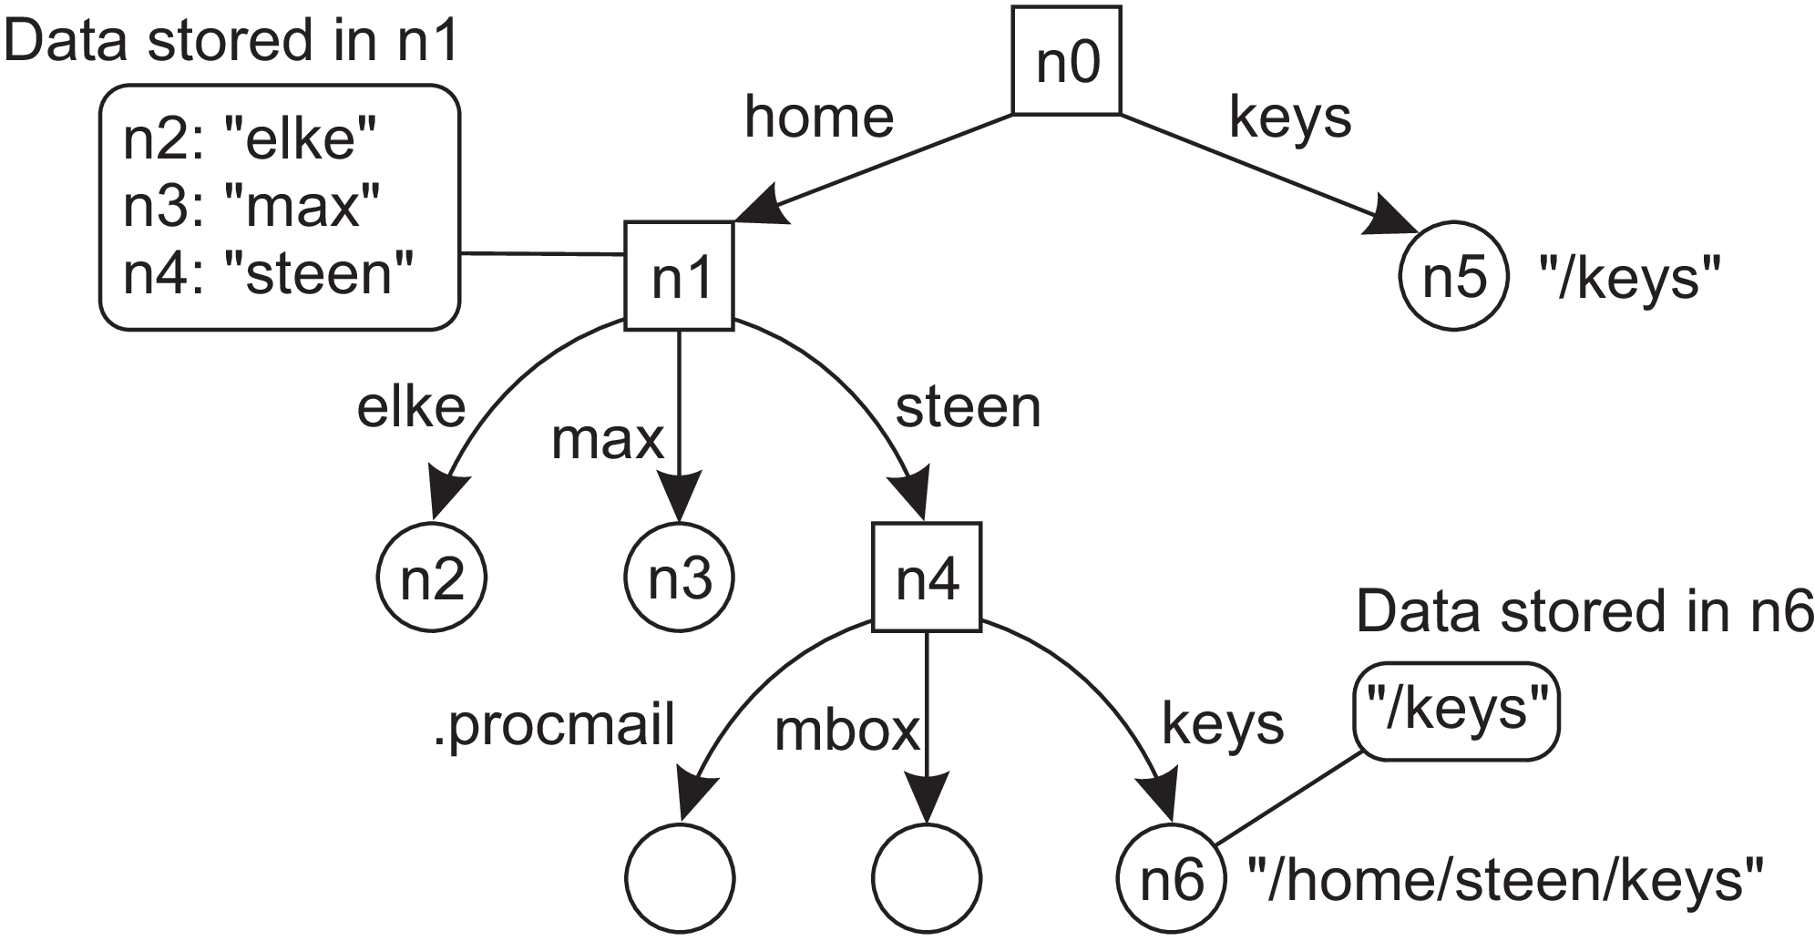
This is symbolic link to
node n5
Figure 5.13: The concept of a symbolic link explained in a naming graph.

Slide 89
In Unix terminology, both path names /keys and /home/steen/keys in Figure 5.13 are called hard links to node n5.
Second approach: The second approach is to represent an entity by a leaf node, say N, but instead of storing the address or state of that entity, the node stores an absolute path name.
When first resolving an absolute path name that leads to N, name resolution will return the path name stored in N, at which point it can continue with resolving that new path name.
This principle corresponds to the use of symbolic links in Unix file systems, and is illustrated in Figure 5.13.

Slide 90
In this example, the path name /home/steen/keys, which refers to a node containing the absolute path name /keys, is a symbolic link to node n5.
Name resolution as described so far takes place completely within a single name space. However, name resolution can also be used to merge different name spaces in a transparent way.
Let us first consider a mounted file system.
In terms of our naming model, a mounted file system corresponds to letting a directory node store the identifier of a directory node from a different name space, which we refer to as a foreign name space.
Mount point Mounting point
FNS
NS FNS

Slide 91
The directory node storing the node identifier is called a mount point. Accordingly, the directory node in the foreign name space is called a mounting point.
Normally, the mounting point is the root of a name space. During name resolution, the mounting point is looked up and resolution proceeds by accessing its directory table.
Consider a collection of name spaces that is distributed across different machines.
In particular, each name space is implemented by a different server, each possibly running on a separate machine.

Slide 92
Consequently, if we want to mount a foreign name space NS2 into a name space NS1, it may be necessary to communicate over a network with the server of NS2, as that server may be running on a different machine than the server for NS1.
To mount a foreign name space in a distributed system requires at least the following information:
1. The name of an access protocol.
2. The name of the server.
3. The name of the mounting point in the foreign name space.

Slide 93
Note that each of these names needs to be resolved. The name of an access protocol needs to be resolved to the implementation of a protocol by which communication with the server of the foreign name space can take place.
The name of the server needs to be resolved to an address where that server can be reached.
As the last part in name resolution, the name of the mounting point needs to be resolved to a node identifier in the foreign name space.

Slide 94
Consider a situation in which a user with a laptop computer wants to access files that are stored on a remote file server.
The client machine and the file server are both configured with the Network File System (NFS).
In particular, to allow NFS to work across the Internet, a client can specify exactly which file it wants to access by means of an NFS URL, for example,
nfs ://flits.cs.vu.nl/home/steen
This URL names a file (which happens to be a directory) called /home/steen on an NFS file server flits.cs.vu.nl, which can be accessed by a client by means of the NFS protocol.

Slide 95
The name nfs is a well-known name in the sense that worldwide agreement exists on how to interpret that name.
Given that we are dealing with a URL, the name nfs will be resolved to an implementation of the NFS protocol. The server name is resolved to its address using DNS.
The organization of a file system on the client machine is partly shown in Figure 5.14.
The root directory has a number of user-defined entries, including a subdirectory called /remote.

Slide 96
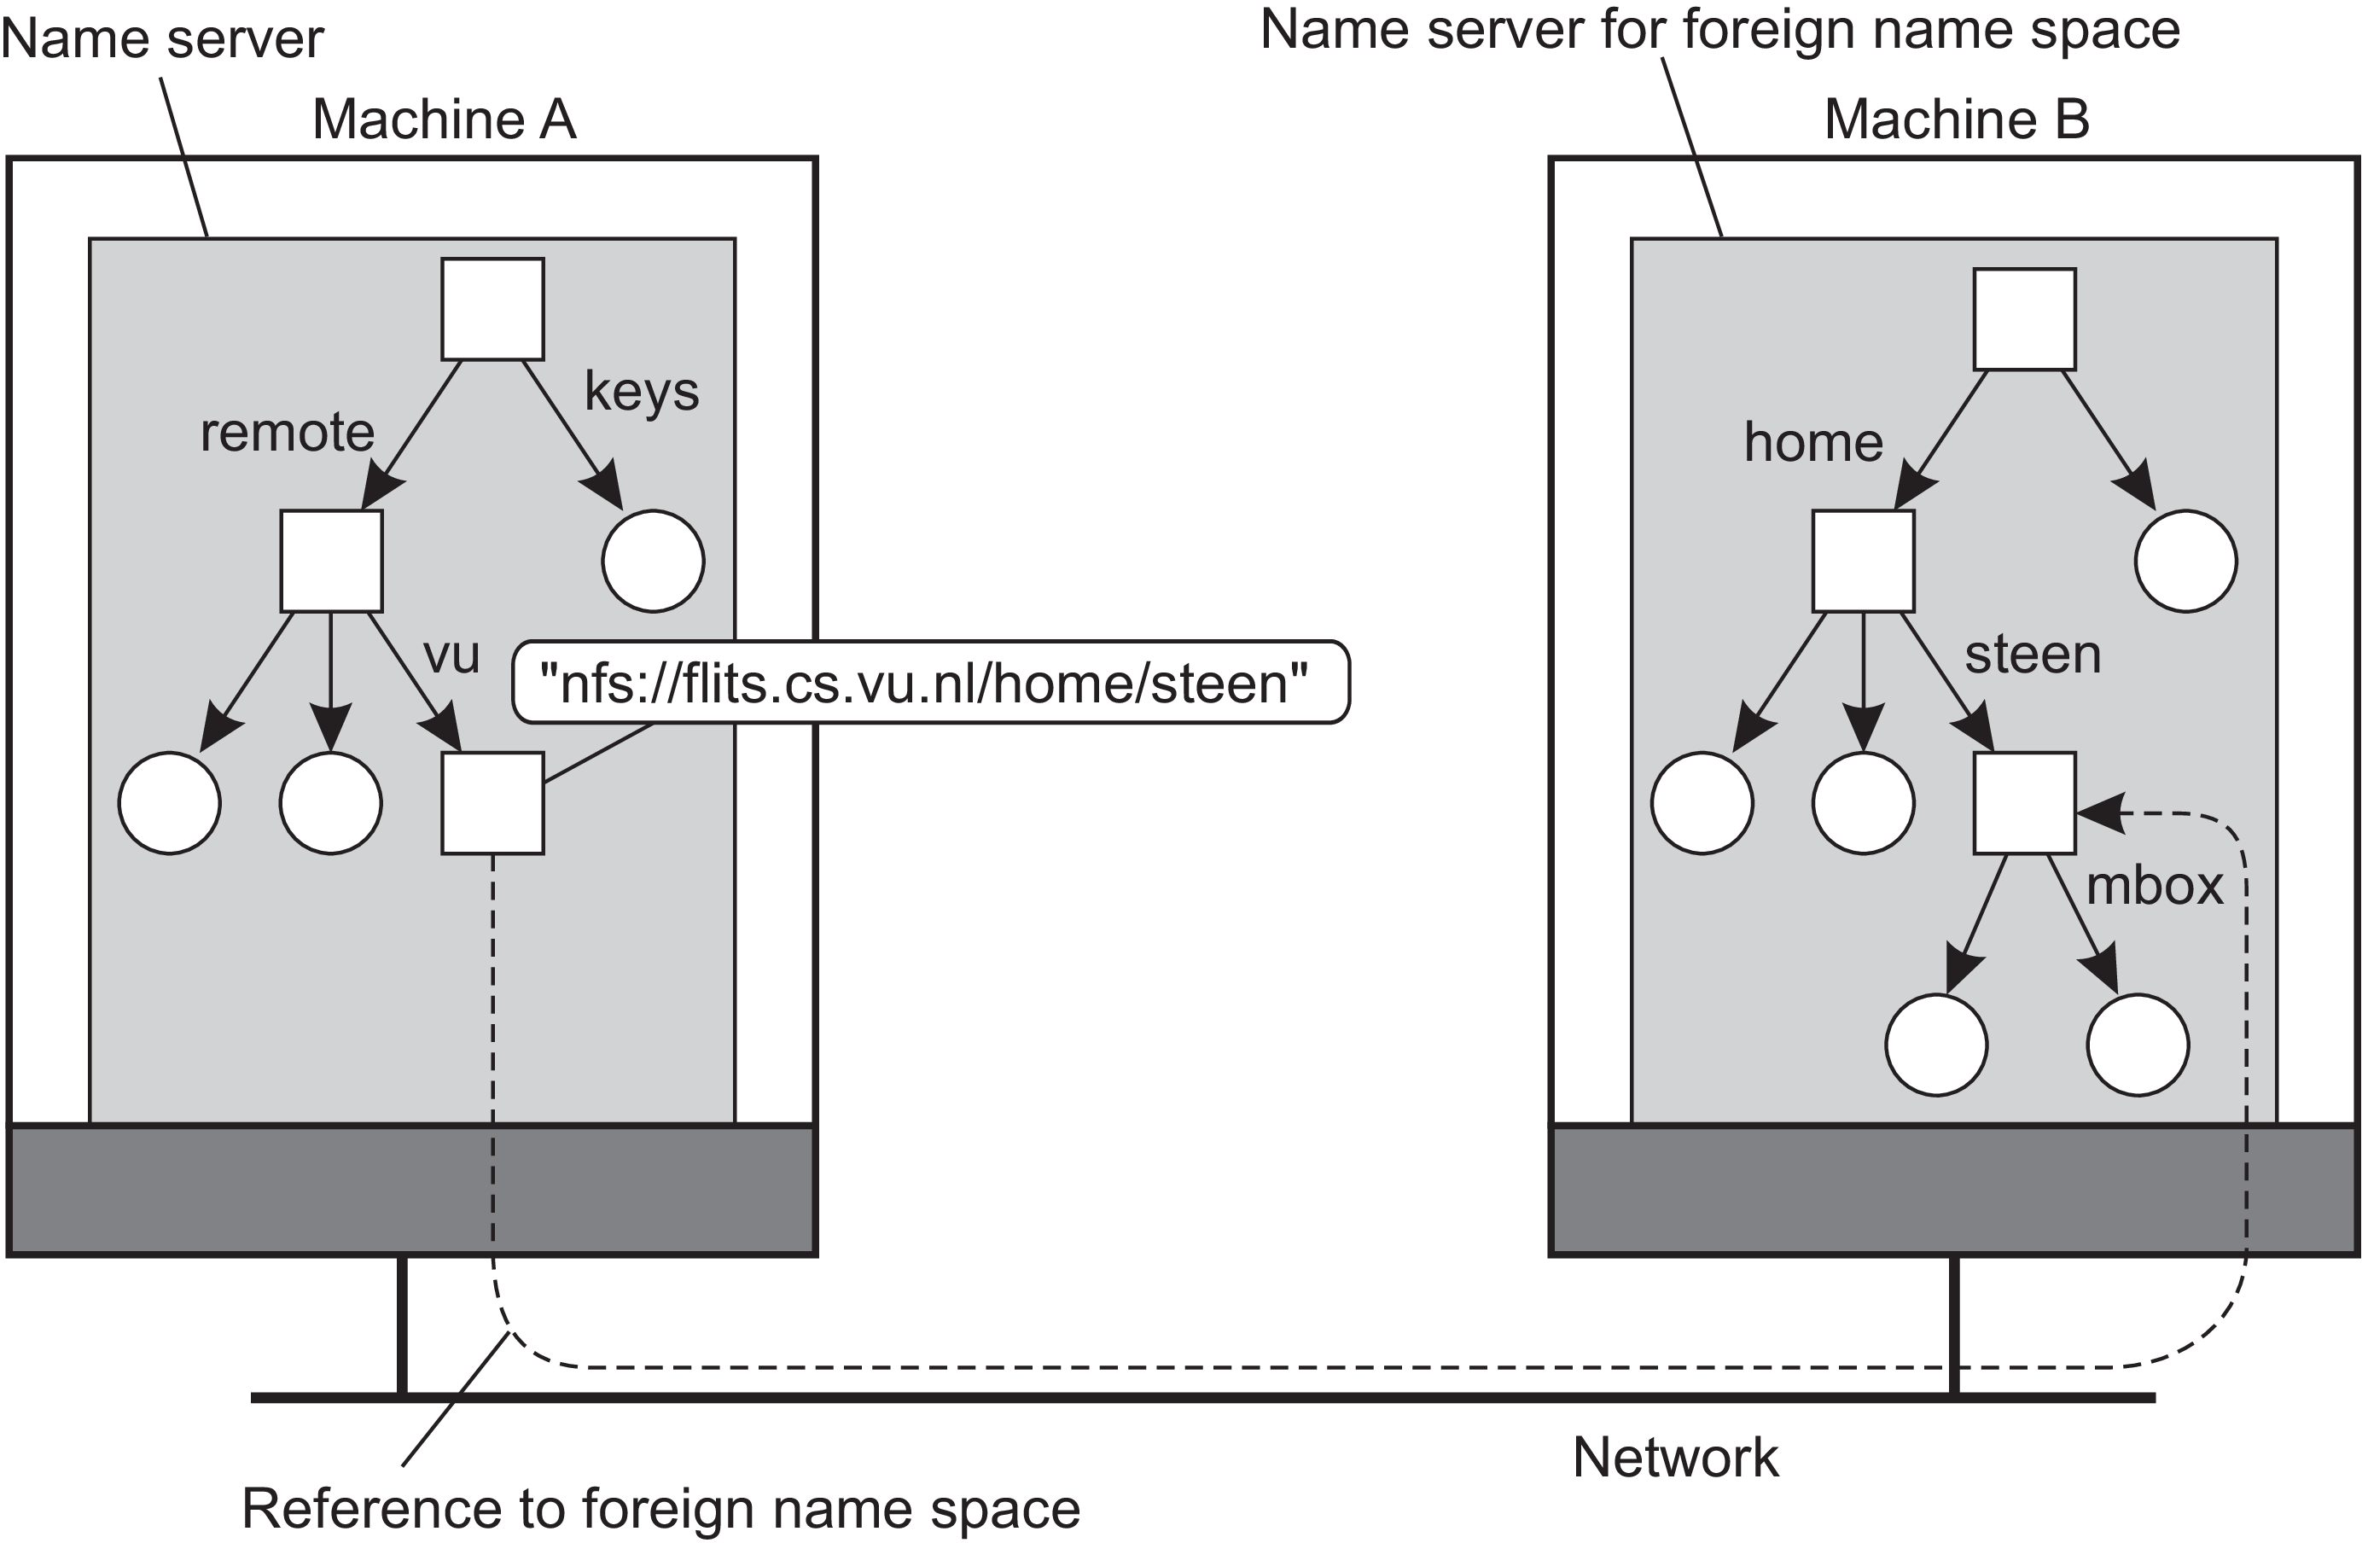
Figure 5.14: Mounting remote name spaces through a specific protocol.

Slide 97
This subdirectory is intended to include mount points for foreign name spaces such as the user’s home directory at VU University.
To this end, a directory node named /remote/vu is used to store the URL,
nfs ://flits.cs.vu.nl/home/steen
Now consider the name /remote/vu/mbox.
This name is resolved by starting in the root directory on the client’s machine and continues until the node /remote/vu is reached.

Slide 98
The process of name resolution then continues by returning the URL
nfs ://flits.cs.vu.nl/home/steen
in turn leading the client machine to contact the file server
flits.cs.vu.nl
by means of the NFS protocol, and to subsequently access directory
/home/steen.
Name resolution can then be continued by reading the file named mbox in that directory, after which the resolution process stops.

Slide 99
Distributed systems that allow mounting a remote file system as just described allow a client machine to, for example, execute the following commands (assume the client machine is named horton):
horton$ cd /remote/vu
horton$ ls -l
which subsequently lists the files in the directory /home/steen on the remote file
server.
To the client it appears that the name space rooted on the local machine, and the one rooted at /home/steen on the remote machine, form a single name space.

Slide 100
The implementation of a name space
A name space forms the heart of a naming service, that is, a service that allows users and processes to add, remove, and look up names.
A naming service is implemented by name servers.
If a distributed system is restricted to a local-area network, it is often feasible to implement a naming service by means of only a single name server.
However, in large-scale distributed systems with many entities, possibly spread across a large geographical area, it is necessary to distribute the implementation of a name space over multiple name servers.

Slide 101
Name space distribution
Name spaces for a large-scale, possibly worldwide distributed system, are usually organized hierarchically.
Assume such a name space has only a single root node.
To effectively implement such a name space, it is convenient to partition it into logical layers.
Cheriton and Mann [1989] distinguish the following three layers.

Slide 102
Global layer
This is formed by highest-level nodes, that is, the root node and other directory nodes logically close to the root, namely its children.
Nodes in the global layer are often characterized by their stability, in the sense that directory tables are rarely changed.
Such nodes may represent organizations, or groups of organizations, for which names are stored in the name space.

Slide 103
Administrational layer
Formed by directory nodes which are managed within a single organization.
The directory nodes in the administrational layer represent groups of entities that belong to the same organization or administrational unit.
Example: There may be a directory node for each department in an organization, or a directory node from which all hosts can be found.
The nodes in the administrational layer are relatively stable, although changes generally occur more frequently than to nodes in the global layer.

Slide 104
Managerial layer
Consists of nodes that may typically change regularly.
Example: Nodes representing hosts in the local network belong to this layer. For the same reason, the layer includes nodes representing shared files such as those for libraries or binaries.
Nodes include those that represent user-defined directories and files.
The nodes in the managerial layer are maintained not only by system administrators, but also by individual end users of a distributed system.

Slide 105
Figure 5.15 shows an example of the partitioning of part of the DNS name space, including the names of files within an organization that can be accessed through the Internet, for example, Web pages and transferable files.
The name space is divided into nonoverlapping parts, called zones in DNS.
A zone is a part of the name space that is implemented by a separate name server. Some of these zones are illustrated in Figure 5.15.
If we take a look at availability and performance, name servers in each layer have to meet different requirements.
Availability: High availability is especially critical for name servers in the global layer. If a name server fails, a large part of the name space will be unreachable because name resolution cannot proceed beyond the failing server.

Slide 106
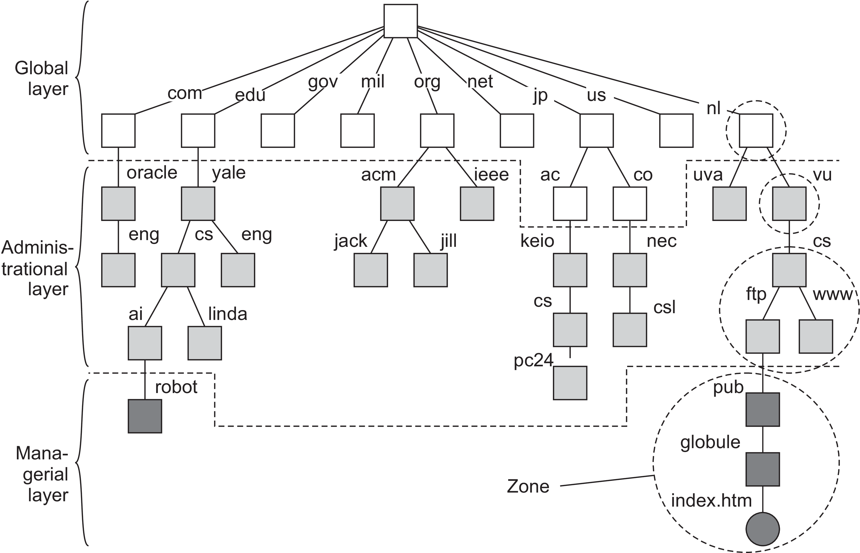
Figure 5.15: An example partitioning of the DNS name space, including Internet-accessible files, into three layers.

Slide 107
Performance: Due to the low rate of change of nodes in the global layer, the results of lookup operations generally remain valid for a long time.
Consequently, those results can be effectively cached (i.e., stored locally) by the clients. The next time the same lookup operation is performed, the results can be retrieved from the client’s cache instead of letting the name server return the results.
As a result, name servers in the global layer do not have to respond quickly to a single lookup request.
Throughput: It may be important, especially in large-scale systems with millions of users.

Slide 108
Global layer
The availability and performance requirements for name servers in the global layer can be met by replicating servers, in combination with client-side caching.
Updates in this layer generally do not have to come into effect immediately, making it much easier to keep replicas consistent.
Administrational layer
Availability for a name server in the administrational layer is primarily important for clients in the same organization as the name server.

Slide 109
If the name server fails, many resources within the organization become unreachable because they cannot be looked up.
On the other hand, it may be less important that resources in an organization are temporarily unreachable for users outside that organization.
With respect to performance, name servers in the administrational layer have similar characteristics as those in the global layer.
Because changes to nodes do not occur all that often, caching lookup results can be highly effective, making performance less critical.

Slide 110
However, in contrast to the global layer, the administrational layer should take care that lookup results are returned within a few milliseconds, either directly from the server or from the client’s local cache.
Likewise, updates should generally be processed quicker than those of the global layer.
For example, it is unacceptable that an account for a new user takes hours to become effective.
These requirements can often be met by using relatively powerful machines to run name servers. In addition, client-side caching should be applied, combined with replication for increased overall availability.

Slide 111
Managerial layer
Availability requirements for name servers at the managerial level are generally less demanding.
In particular, it often suffices to use a single machine to run name servers at the risk of temporary unavailability.
However, performance is crucial: operations must take place immediately.
Because updates occur regularly, client-side caching is often less effective.

Slide 112
A comparison between name servers at different layers is shown in Figure 5.16.

Slide 113
In distributed systems, name servers in the global and administrational layer are the most difficult to implement.
Difficulties are caused by replication and caching, which are needed for availability and performance, but which also introduce consistency problems.
Some of the problems are aggravated by the fact that caches and replicas are spread across a wide-area network, which may introduce long communication delays during lookups.

Slide 114
Implementation of name resolution
The distribution of a name space across multiple name servers affects the implementation of name resolution.
We assume for the moment that name servers are not replicated and that no client-side caches are used.
Each client has access to a local name resolver, which is responsible for ensuring that the name resolution process is carried out.
Referring to Figure 5.15, assume the (absolute) path name
root:[nl, vu, cs, ftp, pub, globe, index.html] is to be resolved.

Slide 115
Figure 5.15: An example partitioning of the DNS name space, including Internet-accessible files, into three layers.

Slide 116
Using a URL notation, this path name would correspond to
ftp://ftp.cs.vu.nl/pub/globe/index.html.
There are now two ways to implement name resolution.
1) Iterative name resolution
In this, a name resolver hands over the complete name to the root name server.
Assume that the address where the root server can be contacted is well known.
The root server will resolve the path name as far as it can, and return the result to the client.

Slide 117
In our example, the root server can resolve only the label nl, for which it will return the address of the associated name server.
At that point, the client passes the remaining path name
(i.e., nl:[vu, cs, ftp, pub, globe, index.html]) to that name server.
This server can resolve only the label vu, and returns the address of the associated name server, along with the remaining path name
vu:[cs, ftp, pub, globe, index.html].
The client’s name resolver will then contact this next name server, which responds by resolving the label cs, and subsequently also ftp, returning the address of the FTP server along with the path name
ftp:[pub, globe, index.html]

Slide 118
The client then contacts the FTP server, requesting it to resolve the last part of the original path name.
The FTP server will subsequently resolve the labels pub, globe, and index.html, and transfer the requested file (in this case using FTP).
This process of iterative name resolution is shown in Figure 5.17.
Note: The notation #[cs] is used to indicate the address of the server responsible for handling the node referred to by [cs].

Slide 119
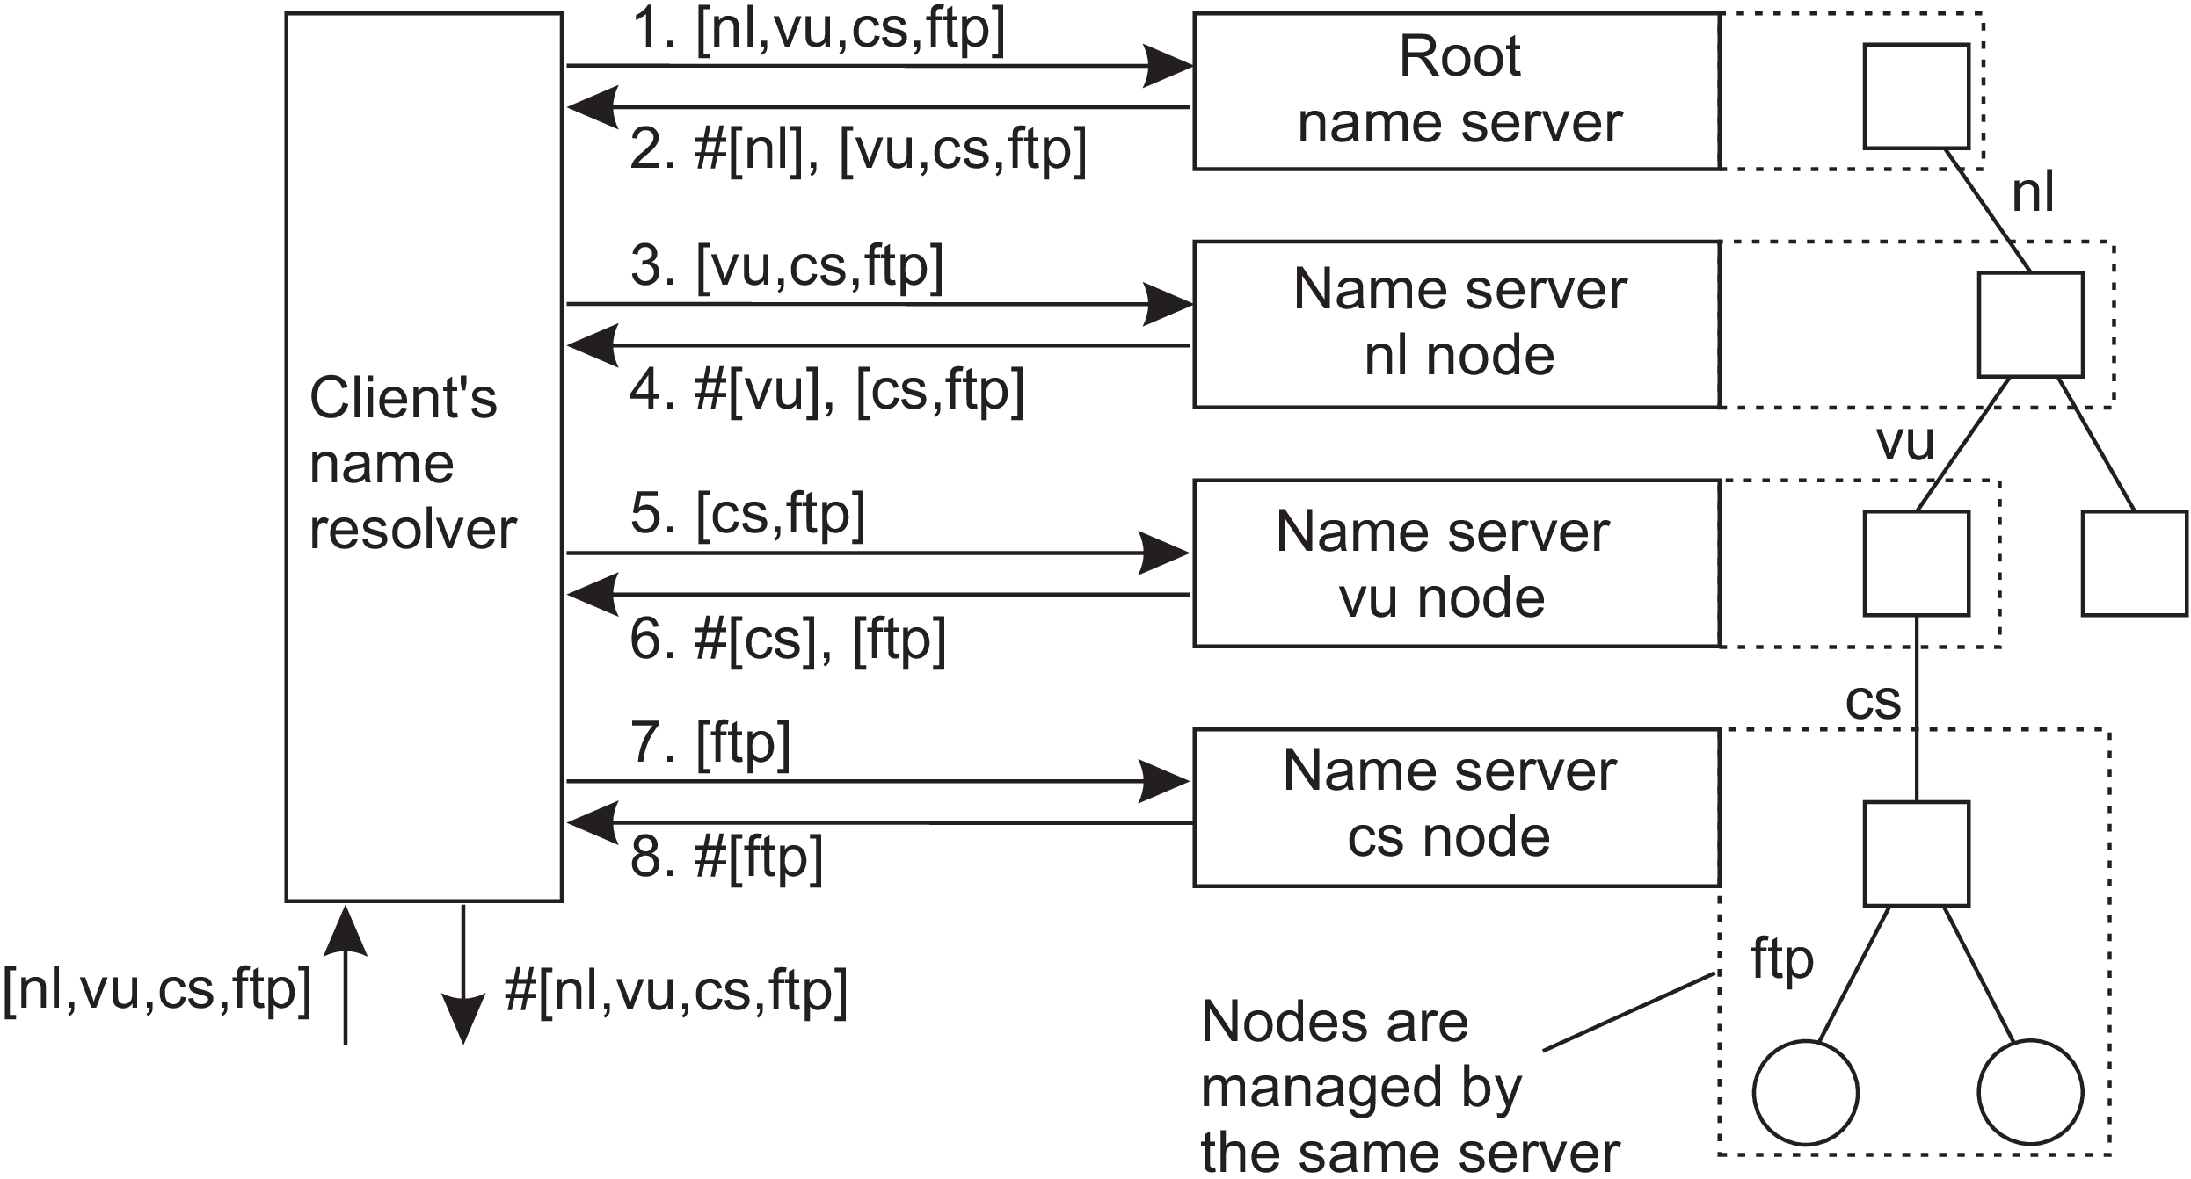
Figure 5.17: The principle of iterative name resolution.

Slide 120
In practice, the last step, namely contacting the FTP server and requesting it to transfer the file with path name ftp:[pub, globe, index.html], is carried out separately by the client process.
In other words, the client would normally hand only the path name root:[nl, vu, cs, ftp] to the name resolver, from which it would expect the address where it can contact the FTP server, as is also shown in Figure 5.17.
2) Recursive name resolution
Uses recursion during name resolution.
Instead of returning each intermediate result back to the client’s name resolver, a name server passes the result to the next name server it finds.

Slide 121
Example
When the root name server finds the address of the name server implementing the node named nl, it requests that name server to resolve the path name
nl:[vu, cs, ftp, pub, globe, index.html].
Using recursive name resolution as well, this next server will resolve the complete path and eventually return the file index.html. to the root server, which, in turn, will pass that file to the client’s name resolver.
Recursive name resolution is shown in Figure 5.18. As in iterative name resolution, the last step (contacting the FTP server and asking it to transfer the indicated file) is generally carried out as a separate process by the client.

Slide 122
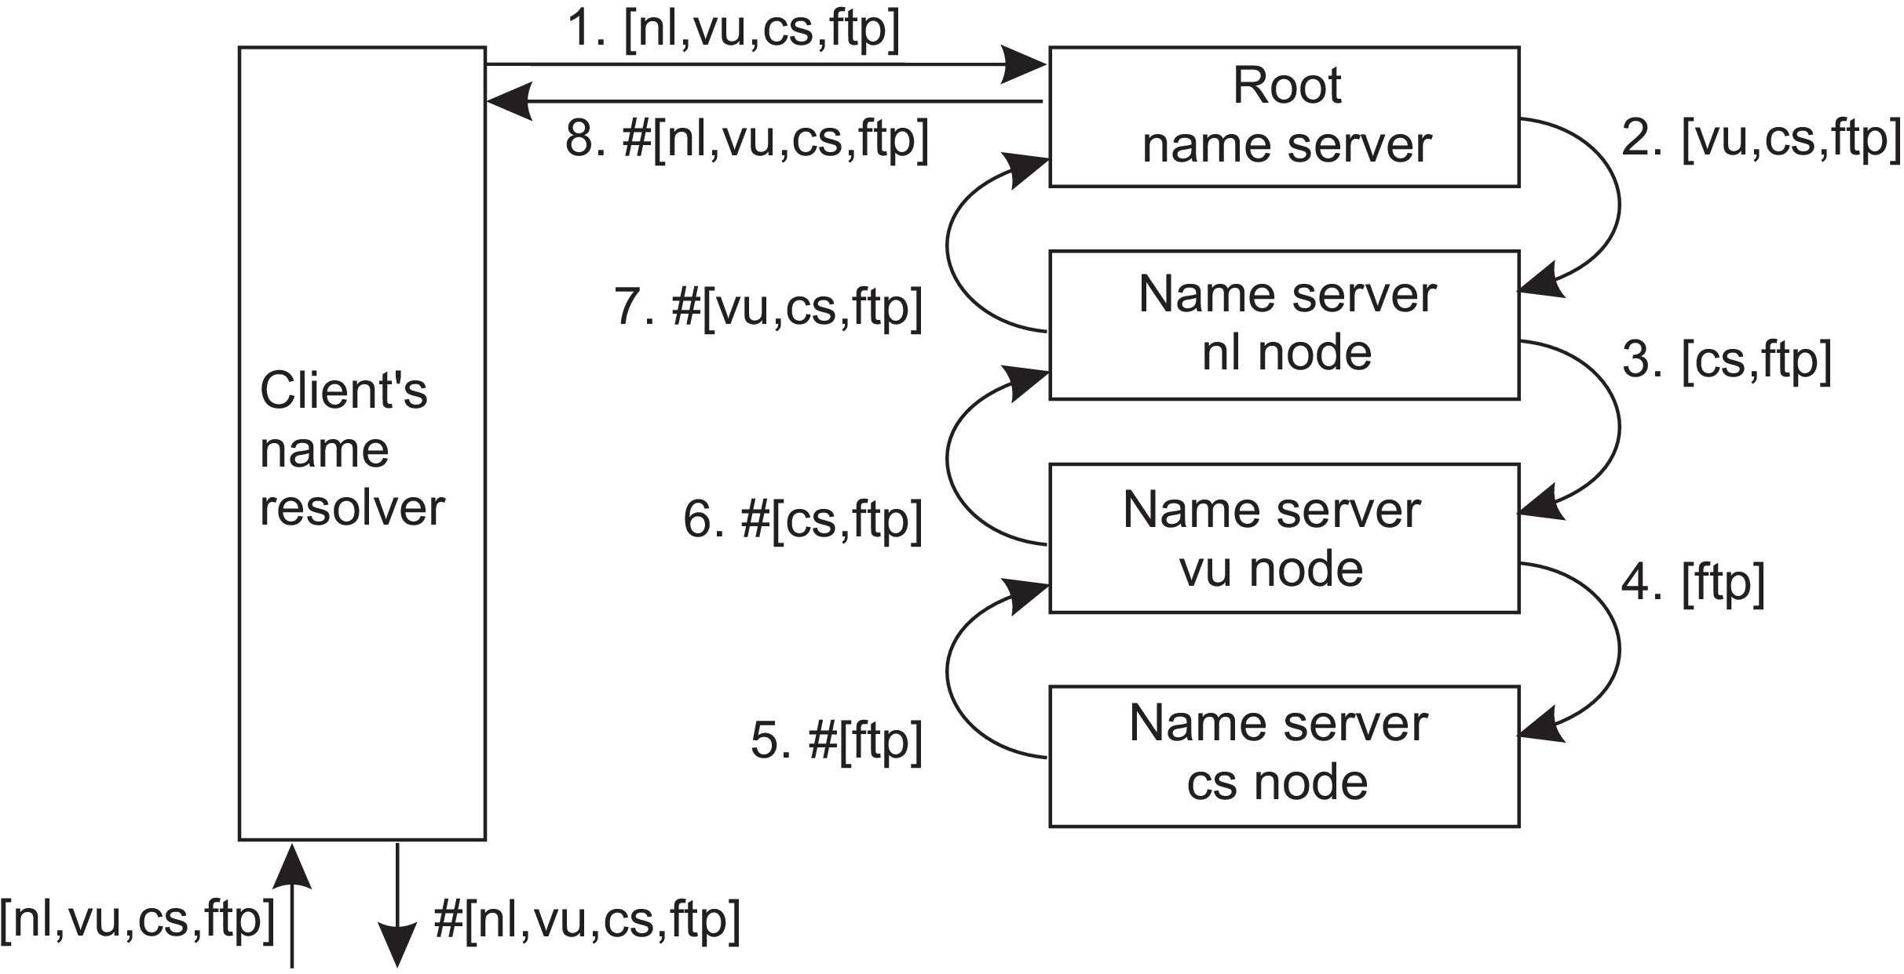
Figure 5.18: The principle of recursive name resolution.

Slide 123
Drawbacks of recursive name resolution
The main drawback of recursive name resolution is that it puts a higher performance demand on each name server.
Basically, a name server is required to handle the complete resolution of a path name, although it may do so in cooperation with other name servers.
This additional burden is generally so high that name servers in the global layer of a name space support only iterative name resolution.

Slide 124
Advantages to recursive name resolution
Caching results is more effective compared to iterative name resolution.
Communication costs may be reduced.
Recursive name resolution allows each name server to gradually learn the address of each name server responsible for implementing lower-level nodes. As a result, caching can be effectively used to enhance performance.
Example: when the root server is requested to resolve the path name
root:[nl, vu, cs, ftp] ,
it will eventually get the address of the name server implementing the node referred to by that path name.

Slide 125
The name server for the nl node has to look up the address of the name server for the vu node, whereas the latter has to look up the address of the name server handling the cs node.
Because changes to nodes in the global and administrational layer do not occur often, the root name server can effectively cache the returned address.
Moreover, because the address is also returned, by recursion, to the name server responsible for implementing the vu node and to the one implementing the nl node, it might as well be cached at those servers too.
Likewise, the results of intermediate name lookups can also be returned and cached.

Slide 126
For example, the server for the nl node will have to look up the address of the vu node server. That address can be returned to the root server when the nl server returns the result of the original name lookup.
A complete overview of the resolution process, and the results that can be cached by each name server is shown in Figure 5.19.
Benefit: Lookup operations can be handled quite efficiently. For example, suppose that another client later requests resolution of the path name
root:[nl, vu, cs, flits].
This name is passed to the root, which can immediately forward it to the name server for the cs node, and request it to resolve the remaining path name cs:[flits].

Slide 128
With iterative name resolution, caching is necessarily restricted to the client’s name resolver.
Consequently, if a client A requests the resolution of a name, and another client B later requests that same name to be resolved, name resolution will have to pass through the same name servers as was done for client A.
Organizations use a local, intermediate name server that is shared by all clients. This local name server handles all naming requests and caches results.
Such an intermediate server is also convenient from a management point of view. For example, only that server needs to know where the root name server is located; other machines do not require this information.

Slide 129
The second advantage of recursive name resolution is that it is often cheaper with respect to communication.
Again, consider the resolution of the path name root:[nl, vu, cs, ftp] and assume the client is located in San Francisco.
Assuming that the client knows the address of the server for the nl node, with recursive name resolution, communication follows the route from the client’s host in San Francisco to the nl server in The Netherlands, shown as R1 in Figure 5.20.
From there on, communication is subsequently needed between the nl server and the name server of VU University on the campus in Amsterdam, The Netherlands.

Slide 130
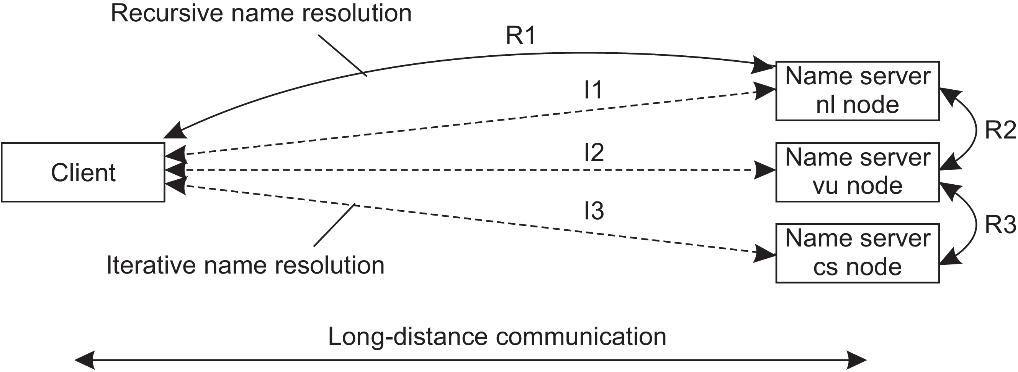
Figure 5.20: The comparison between recursive and iterative name resolution
with respect to communication costs.

Slide 131
This communication is shown as R2. Finally, communication is needed between the vu server and the name server in the Computer Science Department, shown as R3. The route for the reply is the same, but in the opposite direction.
Communication costs are dictated by the message exchange between the client’s host and the nl server.
In contrast, with iterative name resolution, the client’s host has to communicate separately with the nl server, the vu server, and the cs server, of which the total costs may be roughly three times that of recursive name resolution.
The arrows in Figure 5.20 labeled I1, I2, and I3 show the communication path for iterative name resolution.

Slide 132
Example: The Domain Name System
One of the largest distributed naming services in use today is the Internet Domain Name System (DNS).
DNS is primarily used for looking up IP addresses of hosts and mail servers.
The DNS name space
The DNS name space is hierarchically organized as a rooted tree.

Slide 133
Label
A case-insensitive string made up of alphanumeric characters.
A label has a maximum length of 63 characters; the length of a complete path name is restricted to 255 characters.
The string representation of a path name consists of listing its labels, starting with the rightmost one, and separating the labels by a dot (“.”).
The root is represented by a dot. So, for example, the path name root:[nl, vu, cs, flits], is represented by the string “flits.cs.vu.nl.”, which includes the rightmost dot to indicate the root node. The dot is generally omitted for readability.

Slide 134
Because each node in the DNS name space has exactly one incoming edge (with the exception of the root node, which has no incoming edges), the label attached to a node’s incoming edge is also used as the name for that node.
A subtree is called a domain. A path name to its root node is called a domain name.
Just like a path name, a domain name can be either absolute or relative.
The contents of a node is formed by a collection of resource records. There are different types of resource records.
The major ones are shown in Figure 5.21.

Slide 136
A node in the DNS name space will often represent several entities at the same time.
Example
A domain name such as vu.nl is used to represent a domain and a zone.
In this case, the domain is implemented by means of several (nonoverlapping) zones.
SOA (start of authority): This resource record contains information such as an e-mail address of the system administrator responsible for the represented zone, the name of the host where data on the zone can be fetched, and so on.

Slide 137
A (address): This record represents a particular host in the Internet. The A record contains an IP address for that host to allow communication.
If a host has several IP addresses, as is the case with multi-homed machines, the node will contain an A record for each address.
MX (mail exchange): This record is like a symbolic link to a node representing a mail server.
Example: The node representing the domain cs.vu.nl has an MX record containing the name zephyr.cs.vu.nl which refers to a mail server. That server will handle all incoming mail addressed to users in the cs.vu.nl domain. There may be several MX records stored in a node.

Slide 138
SRV : These are related to MX records. These contain the name of a server for a specific service. The service itself is identified by means of a name along with the name of a protocol.
Example: The web server in the cs.vu.nl domain could be named by means of an SRV record such as _http_tcp.cs.vu.nl. This record would then refer to the actual name of the server (which is soling.cs.vu.nl).
Advantage: Clients need no longer know the DNS name of the host providing a specific service. Instead, only service names need to be standardized, after which the providing host can be looked up.

Slide 139
NS: Nodes that represent a zone, contain one or more NS (name server) records. Like MX records, an NS record contains the name of a name server that implements the zone represented by the node.
In principle, each node in the name space can store an NS record referring to the name server that implements it.
CNAME: DNS distinguishes aliases from what are called canonical names. Each host is assumed to have a canonical, or primary name.
An alias is implemented by means of node storing a CNAME record containing the canonical name of a host. The name of the node storing such a record is thus the same as a symbolic link, as was shown in Figure 5.13.

Slide 140
PTR: DNS maintains an inverse mapping of IP addresses to host names by means of PTR (pointer) records.
To accommodate the lookups of host names when given only an IP address, DNS maintains a domain named in-addr.arpa, which contains nodes that represent Internet hosts and which are named by the IP address of the represented host.
Example: Host www.cs.vu.nl has IP address 130.37.20.20.
DNS creates a node named 20.20.37.130.in-addr.arpa, which is used to store the canonical name of that host. (which happens to be soling.cs.vu.nl in a PTR record).

Slide 141
HINFO: Host info record is used to store additional information on a host such as its machine type and operating system.
TXT: These records are used for any other kind of data that a user finds useful to store about the entity represented by the node.

Slide 142
DNS implementation
In essence, the DNS name space can be divided into a global layer and an administrational layer as shown in Figure 5.15.
The managerial layer, which is generally formed by local file systems, is formally not part of DNS and is therefore also not managed by it.
Each zone is implemented by a name server, which is virtually always replicated for availability.
Updates for a zone are normally handled by the primary name server.

Slide 143
Updates take place by modifying the DNS database local to the primary server.
Secondary name servers do not access the database directly, but, instead, request the primary server to transfer its content. The latter is called a zone transfer in DNS terminology.
A DNS database is implemented as a (small) collection of files, of which the most important one contains all the resource records for all the nodes in a particular zone.
This approach allows nodes to be simply identified by means of their domain name, by which the notion of a node identifier reduces to an (implicit) index into a file.

Slide 144
Example: The Network File System
Consider naming in NFS.
The fundamental idea underlying the NFS naming model is to provide clients complete transparent access to a remote file system as maintained by a server.
This transparency is achieved by letting a client be able to mount a remote file system into its own local file system, as shown in Figure 5.24.
Instead of mounting an entire file system, NFS allows clients to mount only part of a file system, as also shown in Figure 5.24.

Slide 145
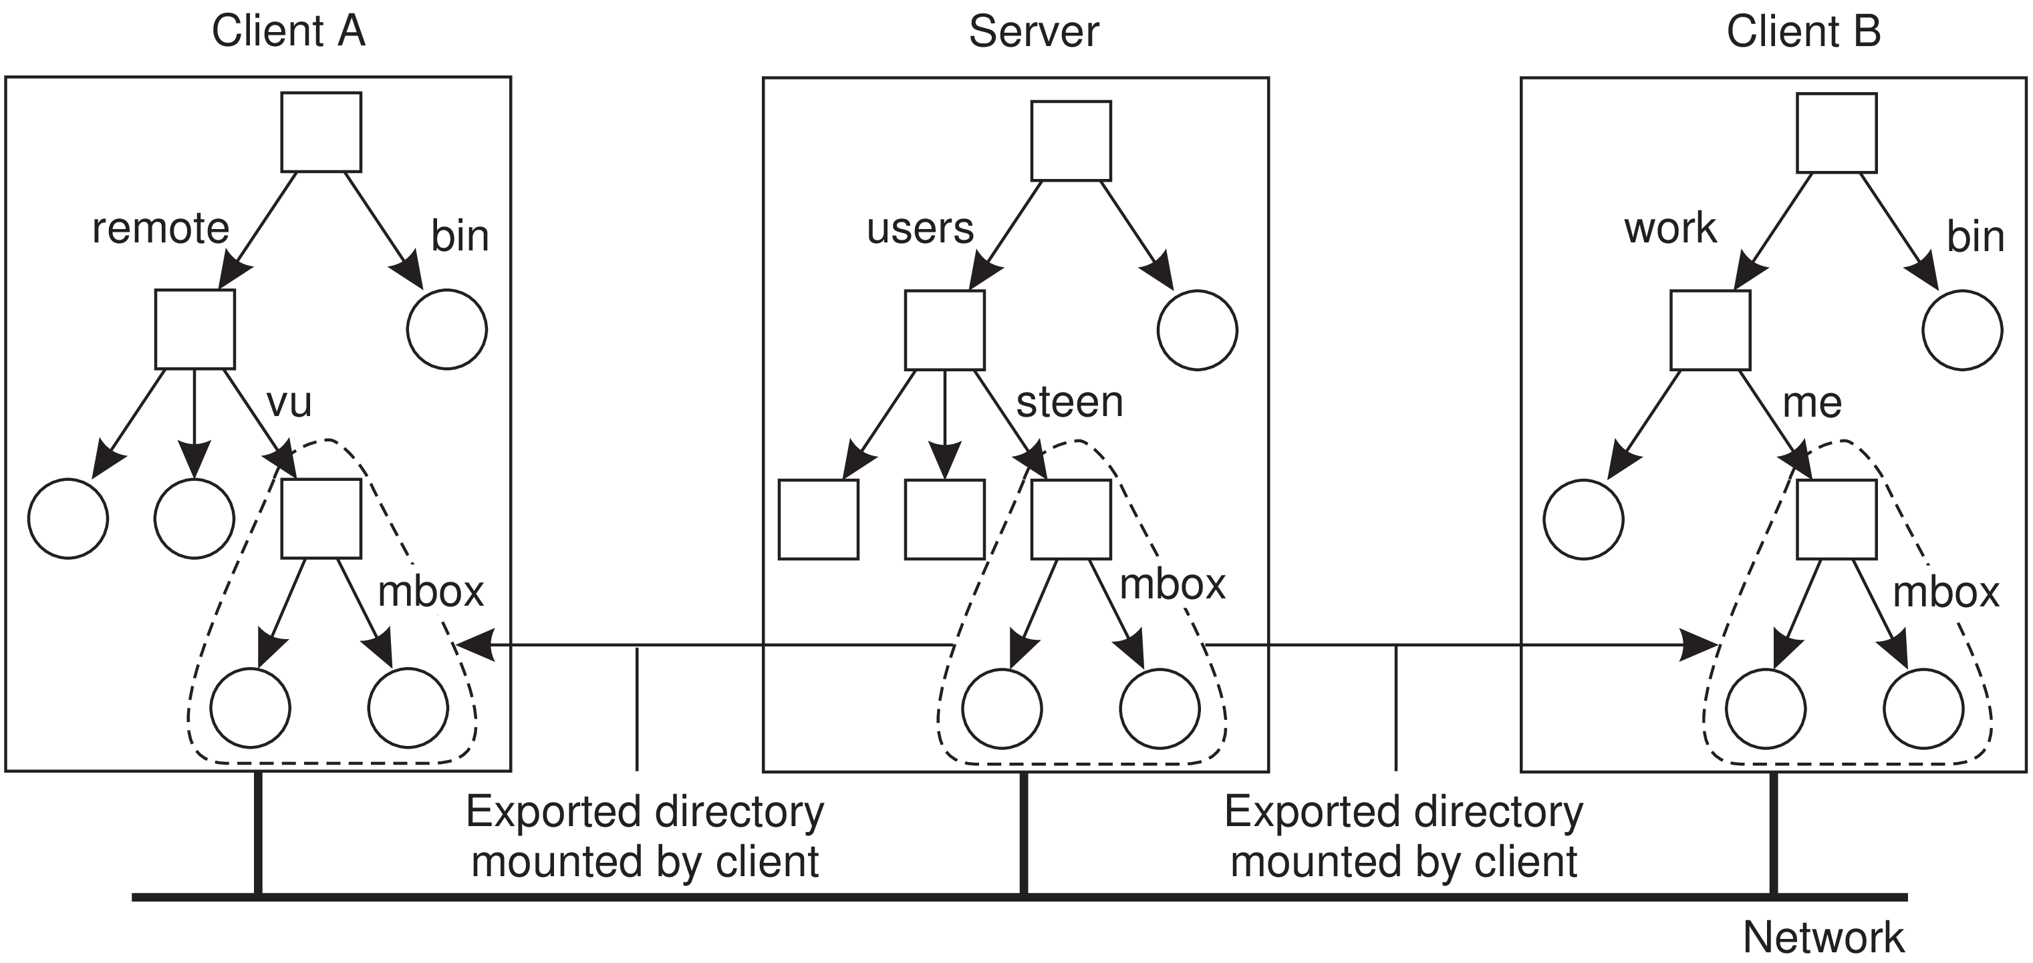
Figure 5.24: Mounting (part of) a remote file system in NFS.

Slide 146
A server is said to export a directory when it makes that directory and its entries available to clients.
An exported directory can be mounted into a client’s local name space.
This design approach has a serious implication: in principle, users do not share name spaces.
As shown in Figure 5.24 the file named /remote/vu/mbox at client A is named /work/me/mbox at client B.
A file’s name therefore depends on how clients organize their own local name space, and where exported directories are mounted.

Slide 147
The drawback of this approach in a distributed file system is that sharing files becomes much harder.
Example, Alice cannot tell Bob about a file using the name she assigned to that file, for that name may have a completely different meaning in Bob’s name space of files.
There are several ways to solve this problem, but the most common one is to provide each client with a name space that is partly standardized.
Example: Each client may be using the local directory /usr/bin to mount a file system containing a standard collection of programs that are available to everyone.

Slide 148
Likewise, the directory /local may be used as a standard to mount a local file system that is located on the client’s host.
An NFS server can itself mount directories that are exported by other servers.
However, it is not allowed to export those directories to its own clients.
Instead, a client will have to explicitly mount such a directory from the server that maintains it, as shown in Figure 5.25.
This restriction comes partly from simplicity. If a server could export a directory that it mounted from another server, it would have to return special file handles that include an identifier for a server. NFS does not support such file handles.

Slide 149
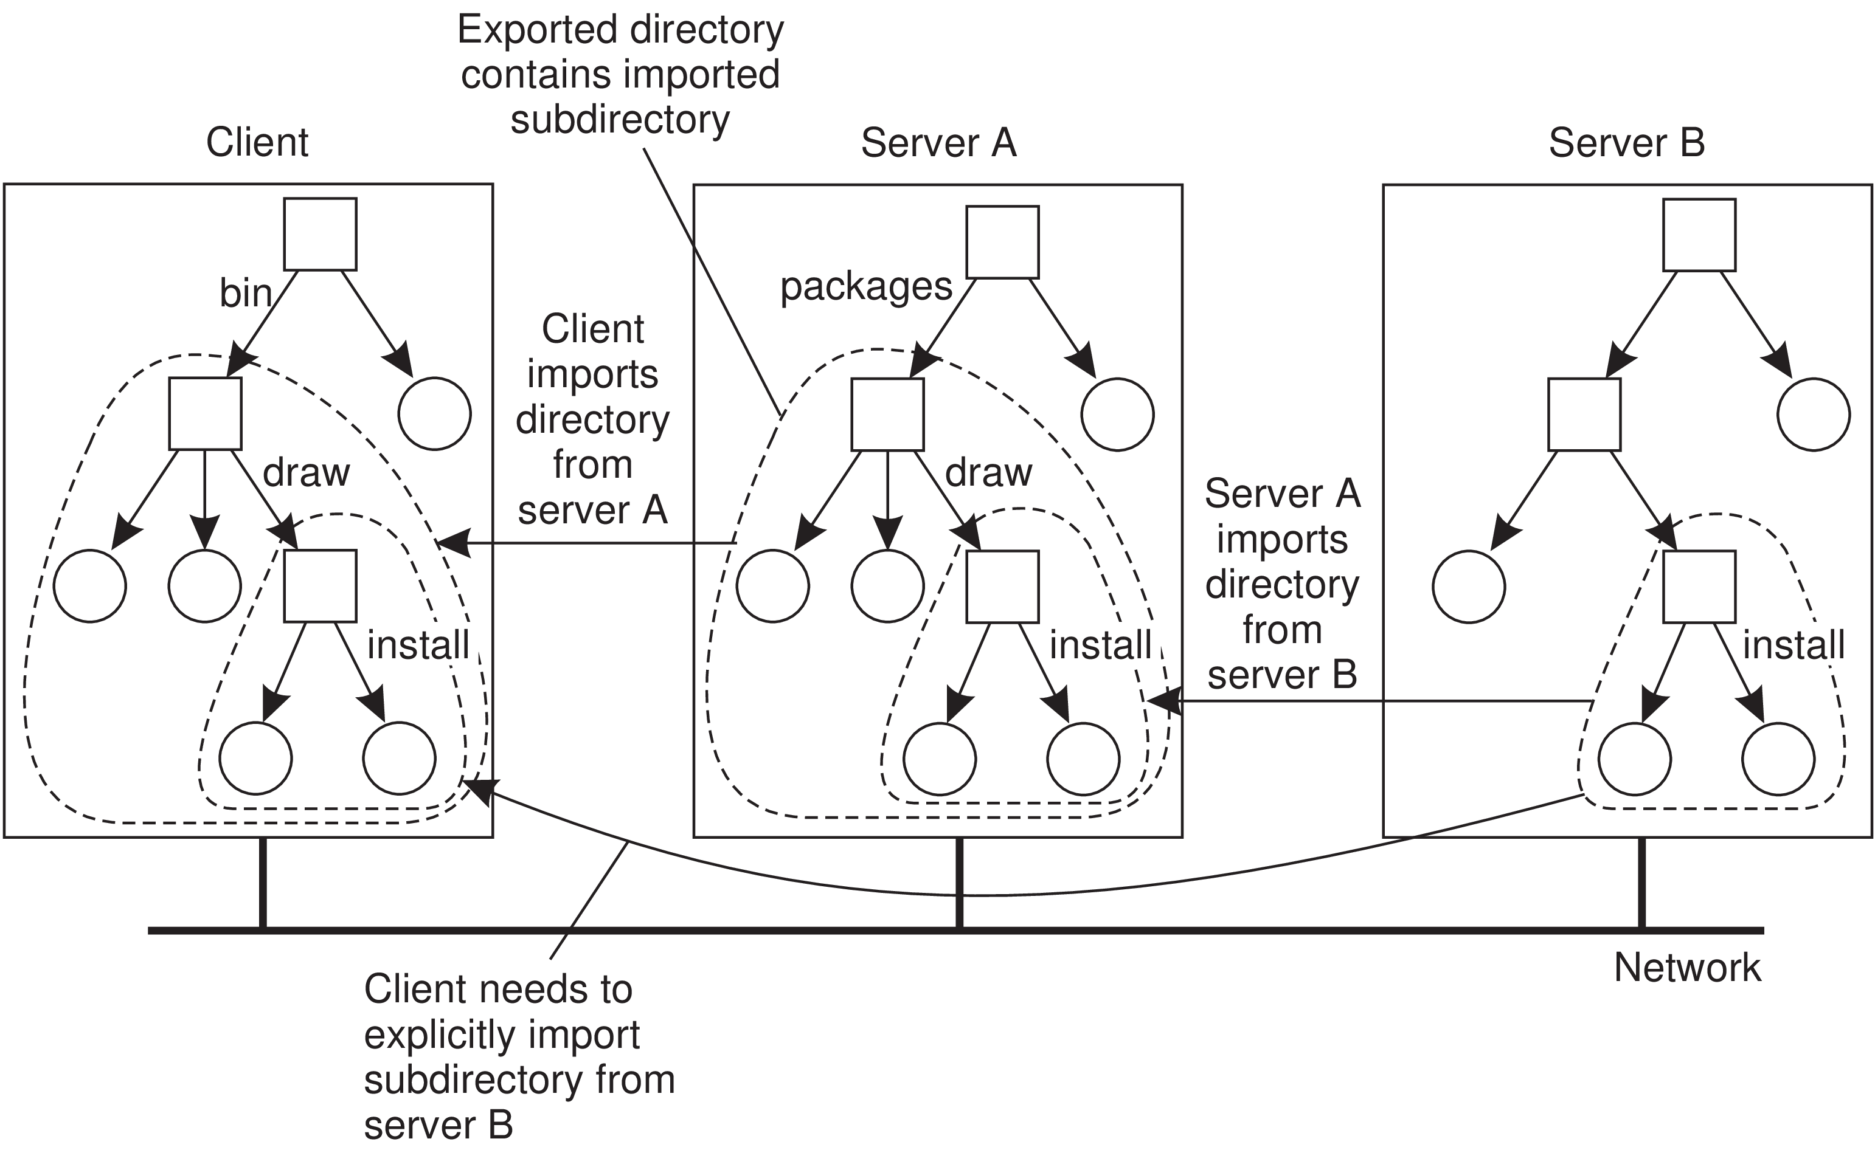
Figure 5.25: Mounting nested directories from multiple servers in NFS

Slide 150
To elaborate - Assume that server A hosts a file system FS_{A} from which it exports the directory /packages.
This directory contains a subdirectory /draw that acts as a mount point for a file system FS_{B} exported by server B and mounted by A.
Let A also export /packages/draw to its own clients, and assume that a client has mounted /packages into its local directory /bin as shown in Figure 5.25.
If name resolution is iterative, then to resolve the name /bin/draw/install, the client contacts server A when it has locally resolved /bin and requests A to return a file handle for directory /draw.

Slide 151
In that case, server A should return a file handle that includes an identifier for server B, for only B can resolve the rest of the path name, in this case /install. This kind of name resolution is not supported by NFS.
Name resolution in earlier versions of NFS is strictly iterative in the sense that only a single file name at a time can be looked up. In other words, resolving a name such as /bin/draw/install requires three separate calls to the NFS server.
Moreover, the client is fully responsible for implementing the resolution of a path name.
NFSv4 also supports recursive name lookups. In this case, a client can pass a complete path name to a server and request that server to resolve it.

Slide 152
There is another peculiarity with NFS name lookups that has been solved with the most recent version (NFSv4).
Consider a file server hosting several file systems.
With the strict iterative name resolution, whenever a lookup is done for a directory on which another file system was mounted, the lookup would return the file handle of the directory.
Subsequently reading that directory would return its original content, not that of the root directory of the mounted file system.

Slide 153
To explain, assume that in our previous example that both file systems FS_{A} and FS_{B} are hosted by a single server.
If the client has mounted /packages into its local directory /bin, then looking up the file name draw at the server would return the file handle for draw.
A subsequent call to the server for listing the directory entries of draw by means of readdir would then return the list of directory entries that were originally stored in FS_{A} in subdirectory /packages/draw.
Only if the client had also mounted file system FS_{B}, would it be possible to properly resolve the path name draw/install relative to /bin.

Slide 154
NFSv4 solves this problem by allowing lookups to cross mount points at a server.
In particular, lookup returns the file handle of the mounted directory instead of that of the original directory.
The client can detect that the lookup has crossed a mount point by inspecting the file system identifier of the looked up file.
If required, the client can locally mount that file system as well.

Slide 155
FILE HANDLE
A file handle is a reference to a file within a file system.
It is independent of the name of the file it refers to.
A file handle is created by the server that is hosting the file system and is unique with respect to all file systems exported by the server.
It is created when the file is created.
The client is kept ignorant of the actual content of a file handle.
File handles were 32 bytes in NFS version 2, but were variable up to 64 bytes in version 3 and 128 bytes in version 4.

Slide 156
A file handle is implemented as a true identifier for a file relative to a file system. This means that as long as the file exists, it should have one and the same file handle.
This persistence requirement allows a client to store a file handle locally once the associated file has been looked up by means of its name.
One benefit is performance: as most file operations require a file handle instead of a name, the client can avoid having to look up a name repeatedly before every file operation.
Another benefit of this approach is that the client can now access the file regardless which (current) name it has.

Slide 157
Because a file handle can be locally stored by a client, it is also important that a server does not reuse a file handle after deleting a file.
Otherwise, a client may mistakenly access the wrong file when it uses its locally stored file handle.
PROBLEM
The combination of iterative name lookups and not letting a lookup operation allow crossing a mount point introduces a problem with getting an initial file handle.

Slide 158
In order to access files in a remote file system, a client will need to provide the server with a file handle of the directory where the lookup should take place, along with the name of the file or directory that is to be resolved.
NFSv3 solves this problem through a separate mount protocol, by which a client actually mounts a remote file system.
After mounting, the client is passed back the root file handle of the mounted file system, which it can subsequently use as a starting point for looking up names.
In NFSv4, this problem is solved by providing a separate operation putrootfh that tells the server to solve all file names relative to the root file handle of the file system it manages.

Slide 159
The root file handle can be used to look up any other file handle in the server’s file system.
This approach has the additional benefit that there is no need for a separate mount protocol.
Instead, mounting can be integrated into the regular protocol for looking up files.
A client can simply mount a remote file system by requesting the server to resolve names relative to the file system’s root file handle using putrootfh.

Slide 160
~ ~ ~ END ~ ~ ~

